Slide 1
Kunsthistoriske nedslag med fokus på mad og moderne kunst med mad
Jf. teksten: MUMS. Mad som kunst & kunst som mad
Af Karen Grøn: museumsdirektør på museet Trapholt i Kolding
og Eva de la Fuente Pedersen: seniorforsker og museumsinspektør på SMK.

Slide 2
Antikken:
En appetitvækker på væggen

Slide 3
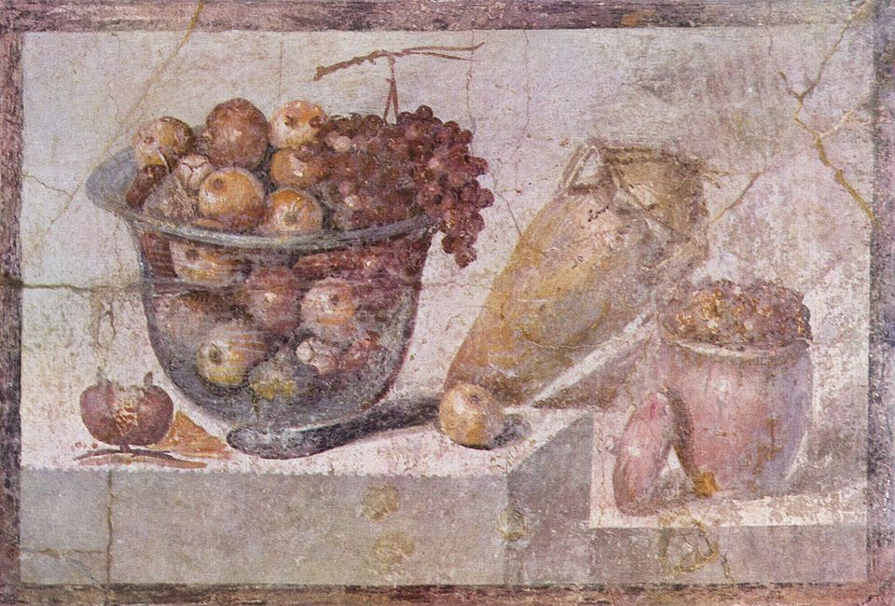
Stilleben, Pompeji, 70 e.Kr.

Slide 4
1400 - 1500-tallet:
Symbolske madvarer

Slide 5
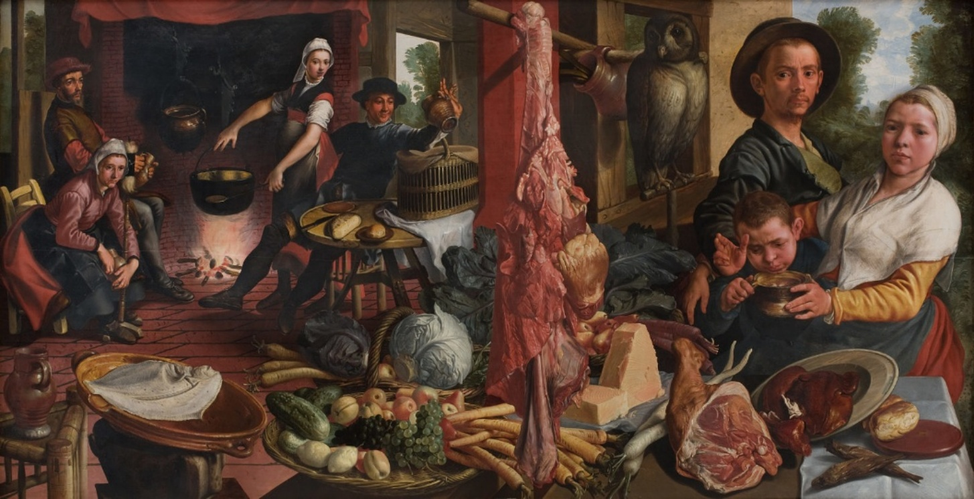
Pieter Aertsen:
Det fede køkken. En allegori. (“Voluptas Carnis”), 1565-1575, SMK.

Slide 6
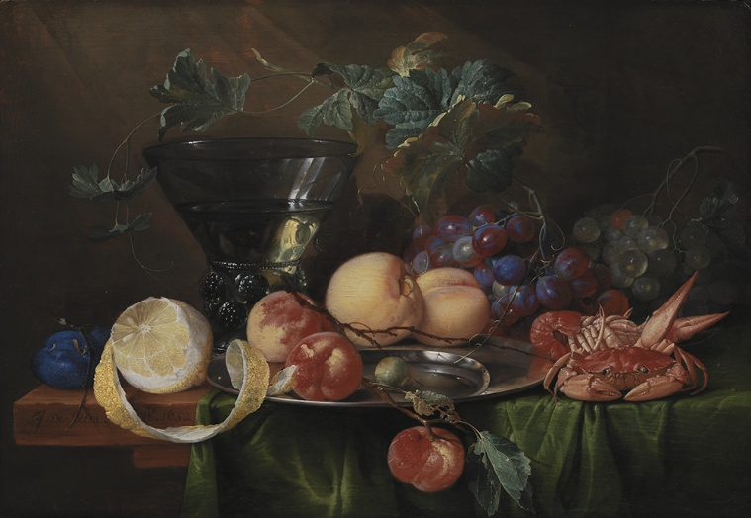
Jan Davidsz. de Heem: Stilleben med en Römer, 1652, SMK.

Slide 7
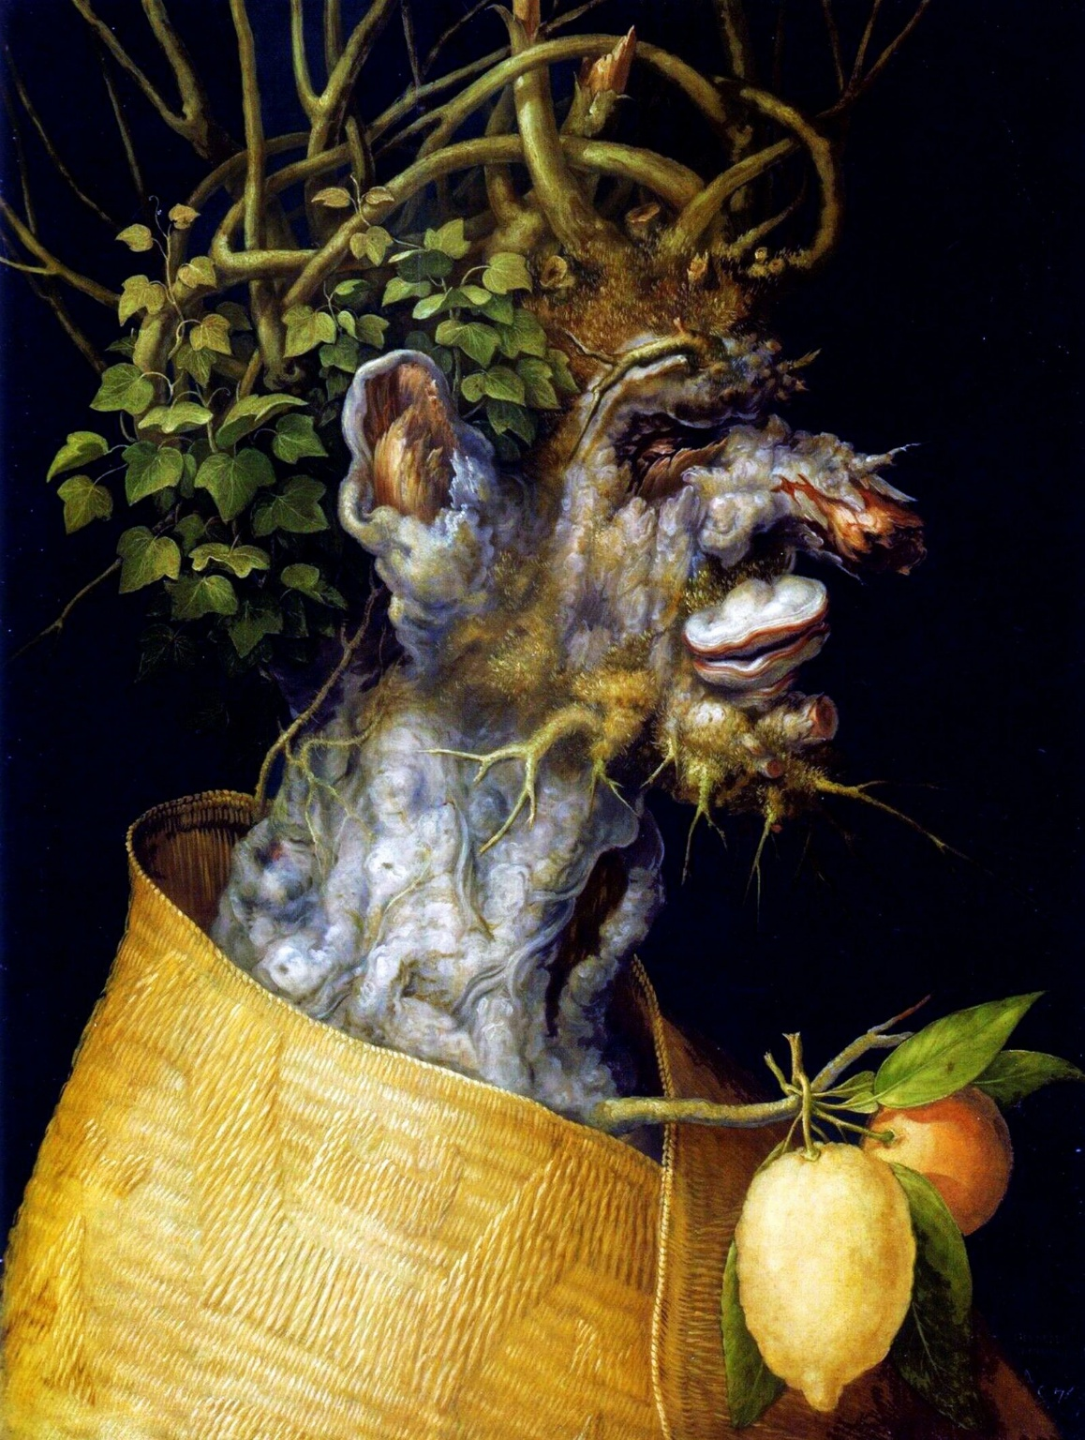
Giuseppe Arcimboldo:
Vinter, 1563.
I 1500-tallet fungerede mad typisk som en kommentar til hovedmotivet. Den italienske maler Giuseppe Arcimboldo lod dog maden være i fokus og brugte madvarerne til at skabe allegoriske fremstillinger af årstiderne.

Slide 8
1700 - 1900-tallet:
Mad er mad – intet andet

Slide 9
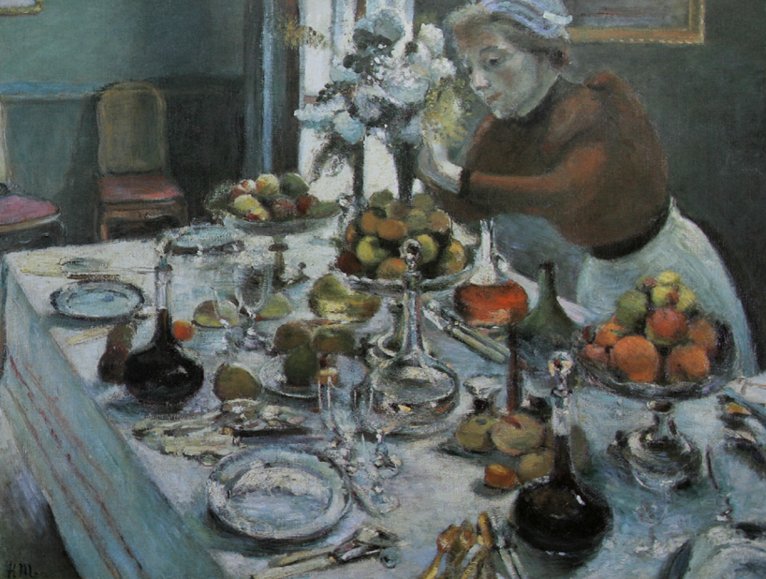
Henri Matisse:
The Dinner Table, 1897
100x131 cm

Slide 10
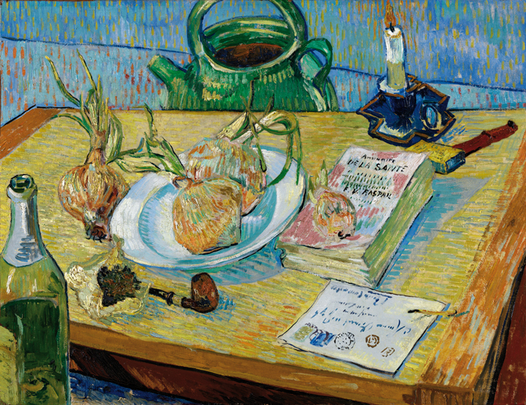
Vincent van Gogh: Stilleben med en tallerken løg, 1889.
Olie på lærred
49,6xx64,4 cm

Slide 11
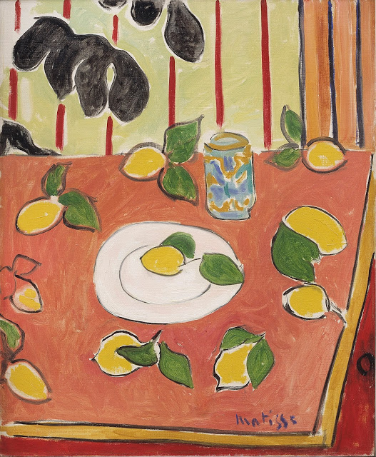
Henri Matisse:
Sort filodendron og citroner,1943.
73 x 60 cm
Olie på lærred

Slide 12
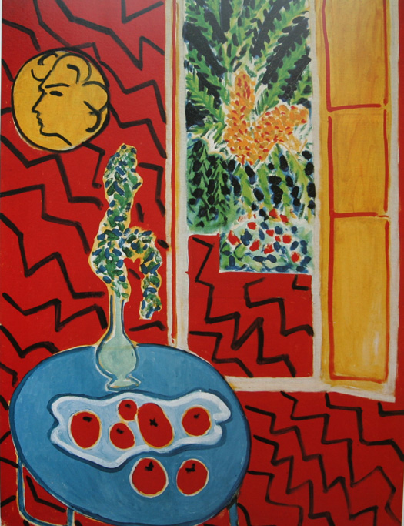
Henri Matisse:
Rødt interiør, stilleben på blåt bord, 1947
116 x 89 cm

Slide 13
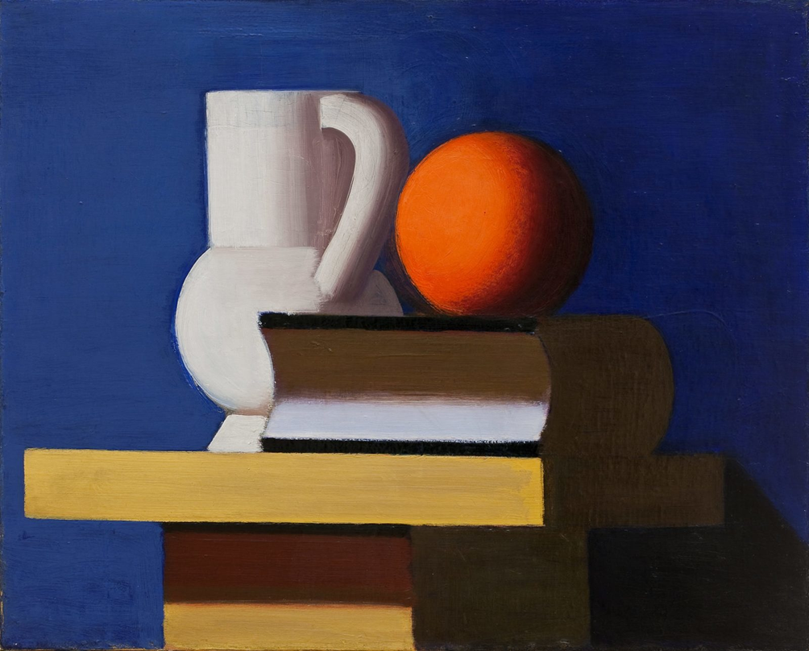
Vilhelm Lundstrøm:
Opstilling med hvid kande, appelsin og bog, 1932-33.

Slide 14
Fra 60'erne:
Mad som materiale

Slide 15
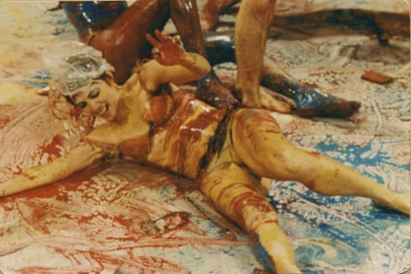
Carolee Schneemann performing “Meat Joy” in 1964.
Photograph: 2021 Estate of Robert R. McElroy/2021 Carolee Schneemann Foundation / Artists Rights Society (ARS), New York / DACS, London.
Notes:
Schneemann was inspirational, confrontational and joyously excessive, pulling art from her vagina and writhing naked through molasses and wallpaper paste. This thrilling show captures the sheer scope of a phenomenal artist
Adrian Searle
Wed 7 Sep 2022 19.18 CEST
Share
The semi-naked performers writhe about the floor, getting lewd and intimate with the dead mackerel, hotdogs, plucked chickens and other offerings being strewn among them by someone wearing an apron. There seems to be a lot of wet paint and plastic tarp lubricating all the flailing about in Meat Joy, which the artist, Carolee Schneemann, described as “an erotic rite”. The footage is grainy, the air of worthy transgression a picture of its time. It was 1964. Do not point that mackerel at me.
Meat Joy was first performed at a festival in Paris, where a male spectator apparently attempted to strangle the artist. Schneemann – and her accomplices from New York’s Judson Dance Theater – performed again a few days later in London, and were chased off the stage by the police, before being exfiltrated in a fleet of cars. Some time later, London’s Whitechapel Gallery restaged the event, but without the police.
Kilde: https://www.theguardian.com/artanddesign/2022/sep/07/carolee-schneemann-barbican-vagina-mackerel-police-review

Slide 16
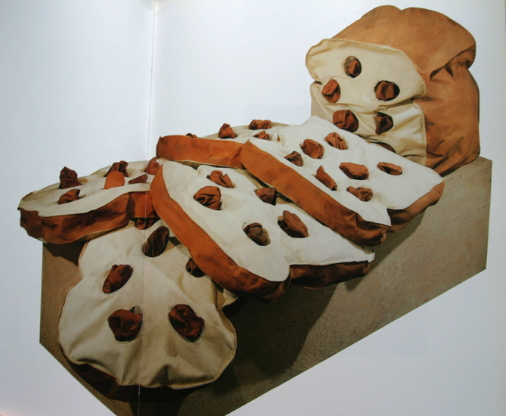
Claes Oldenburg:
Giant loaf of raisin bread, sliced, 1966-67
117 x 244 x 102 cm

Slide 17
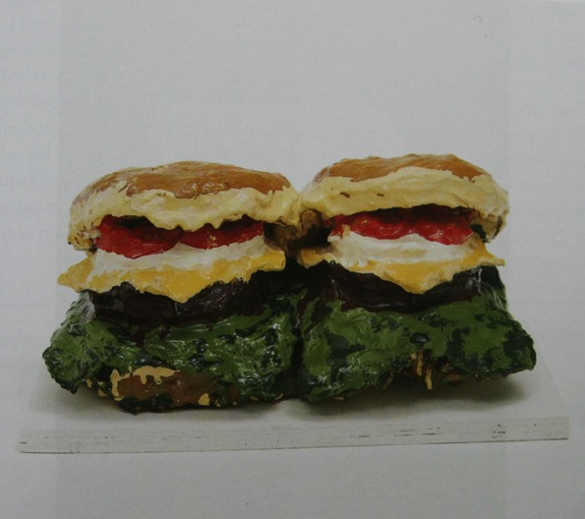
Claes Oldenburg:
Dobbelt hamburger, 1962
Hessian og gips med emaljemaling.
18 x 38 x 27 cm.

Slide 18
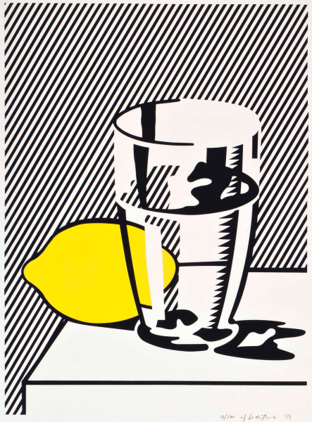
Roy Lichtenstein:
Uden titel. Stilleben med citron og glas, 1974
Silketryk på papir
(100 eksemplarer)
102,6 x 80,8 cm

Slide 19
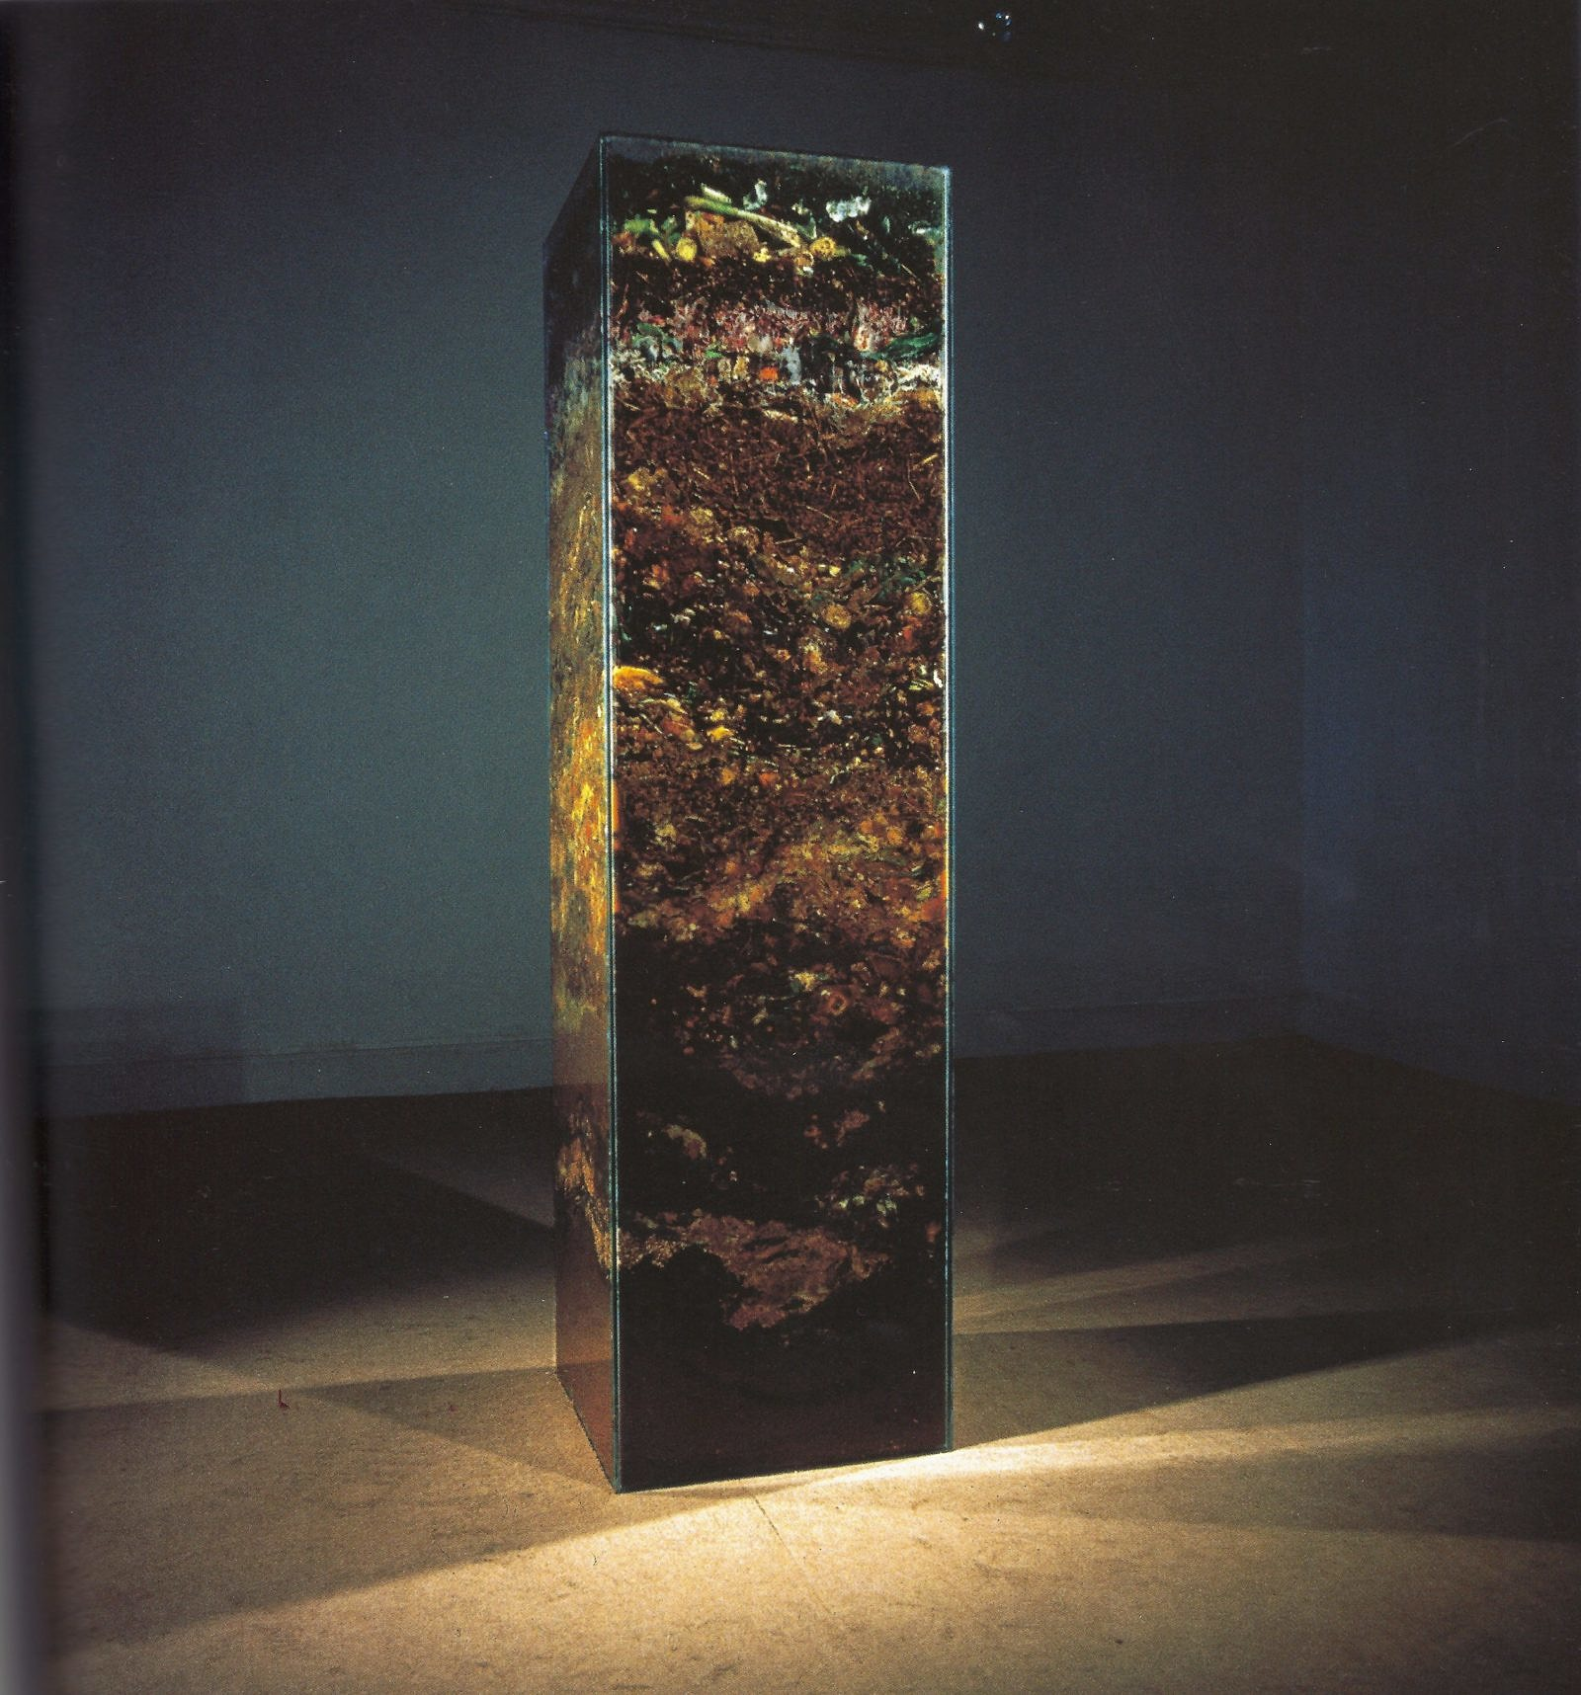
Helen Chadwick: Carcass, 1986/2017.
Et tårn af rådden kompost. Værket kan betragtes som et moderne stilleben med vanitassymbolik, der minder os om livets forgængelighed.

Slide 20
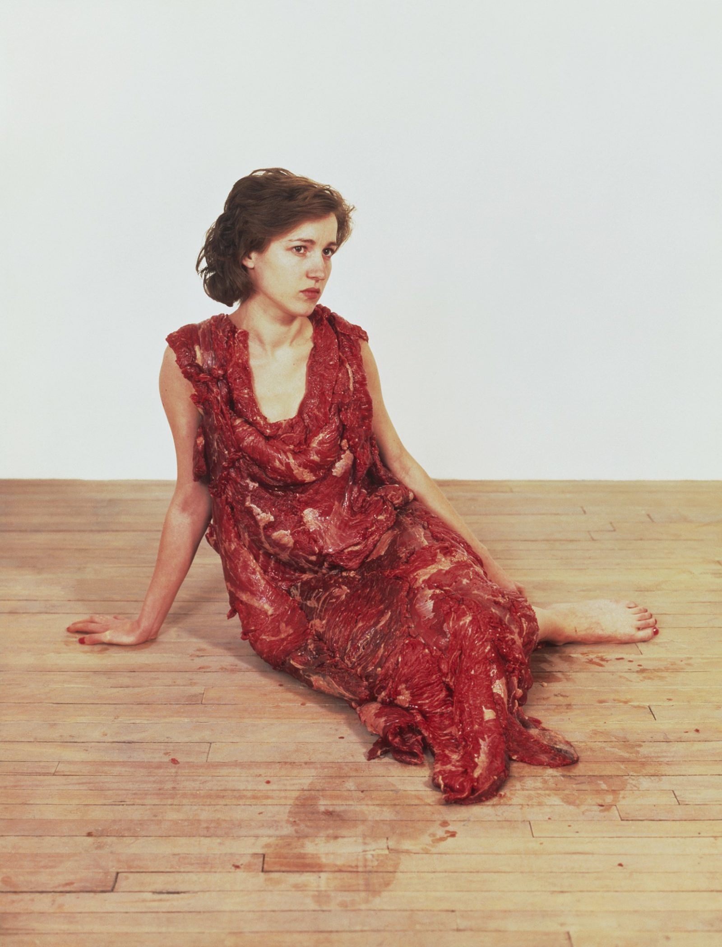
Jana Sterbak:
Vanitas: Flesh Dress for an Albino Anorectic, 1987.
Kødkjole syet af 55 rå bøffer.

Slide 21
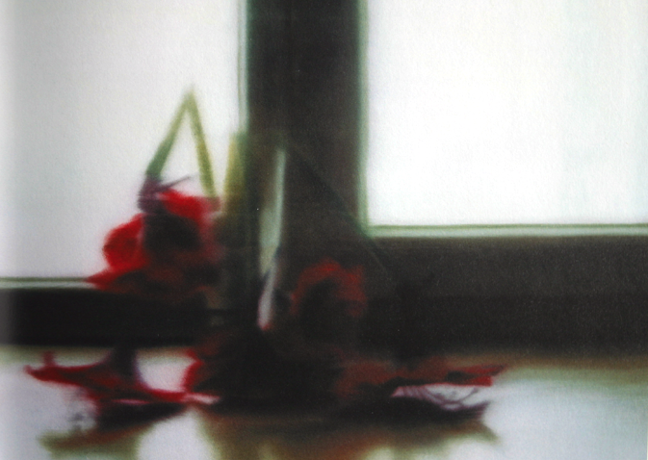
Gerhard Richter:
Blomster, 1994
Olie på lærred
51 x 71 cm

Slide 22
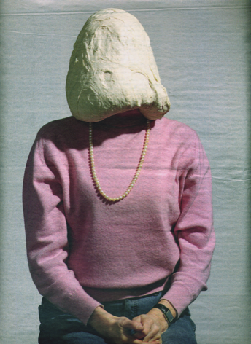
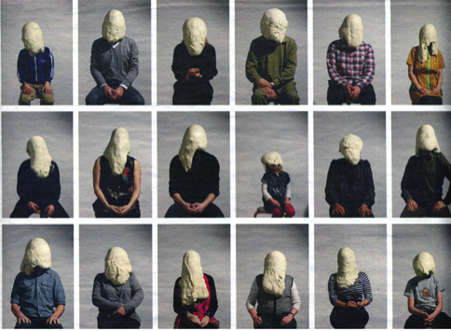
Søren Dahlgaard:
Dejportrætter, 2008
Karen 61
Fotografi

Slide 23
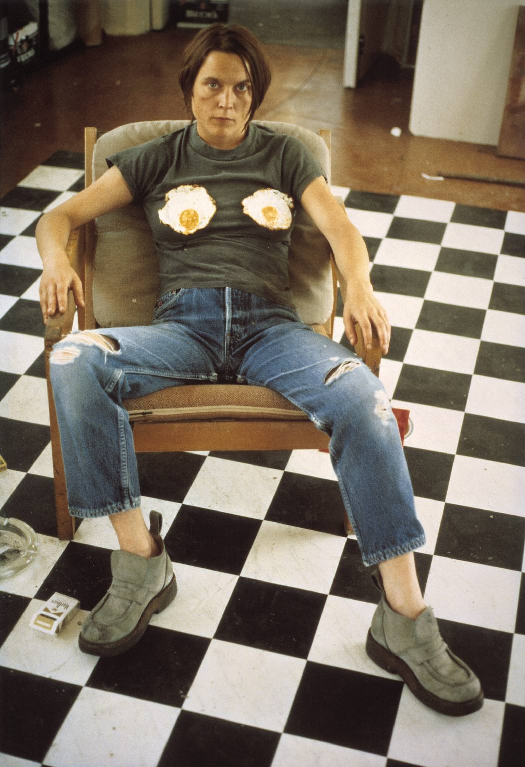
Sarah Lucas:
Selvportræt med spejlæg, 1996
74,6 x 51,5 cm

Slide 24
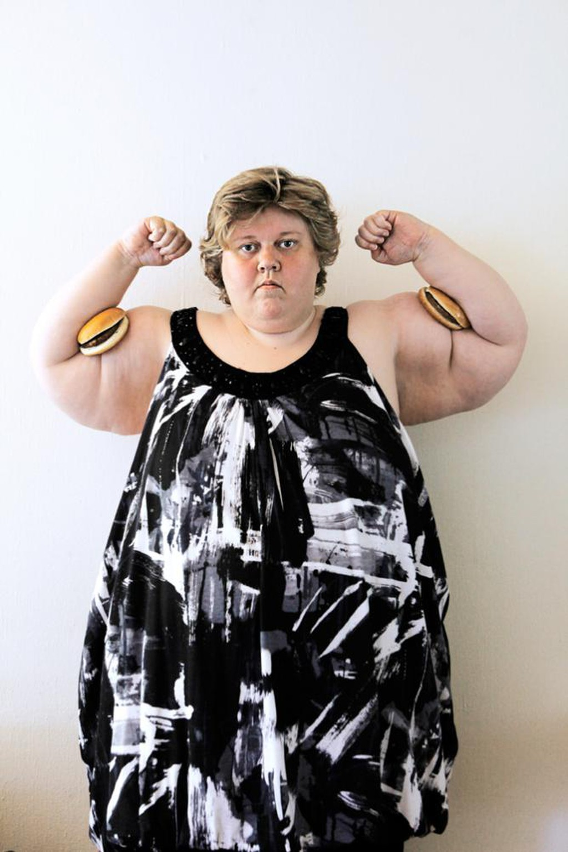
Liu Susiraja:
Power Woman, 2011
Fotografi

Slide 25
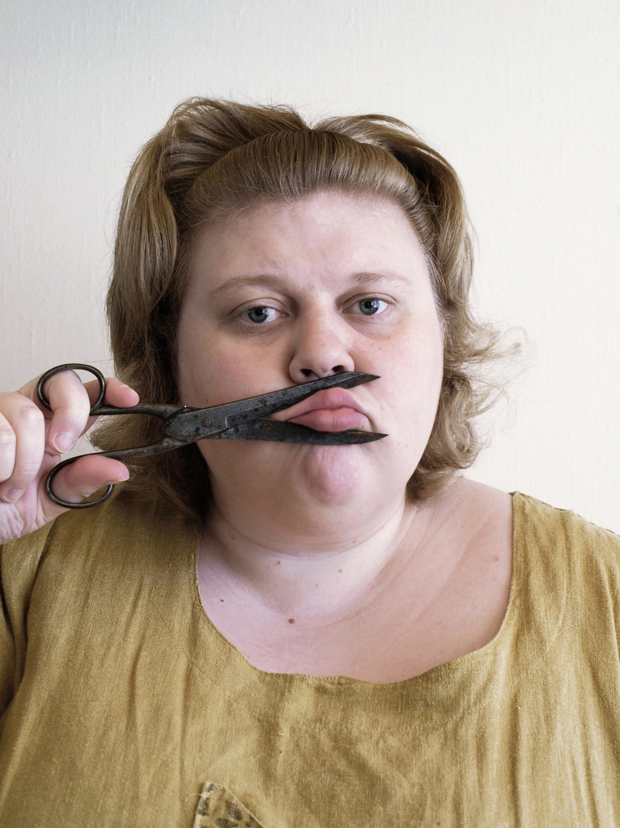
Iiu Susiraja:
Hands Handy, Good Behaviour, 2008-10.

Slide 26
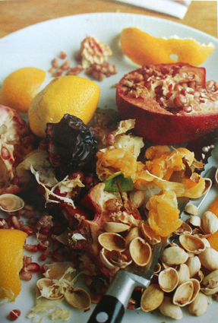
Wolfgang Tillmans: Still Home, 1996
40 x 30 cm
Fotografi

Slide 27
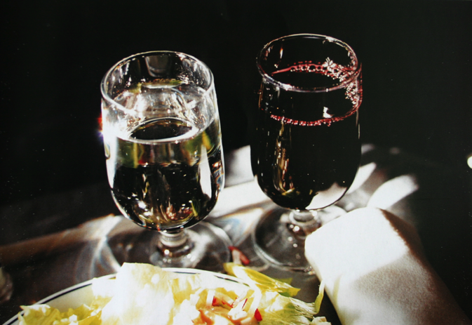
Wolfgang Tillmans:
Water and wine, 2001
C-print fotografi
51 x 61 cm

Slide 28
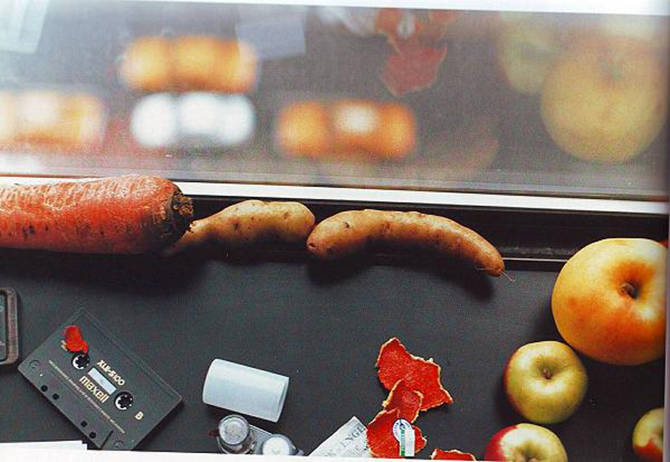
Wolfgang Tillmans:
Still life , New York, 2001
C-print fotografi
40,6 x 30,5 cm

Slide 29
Nu: Spis kunsten

Slide 30
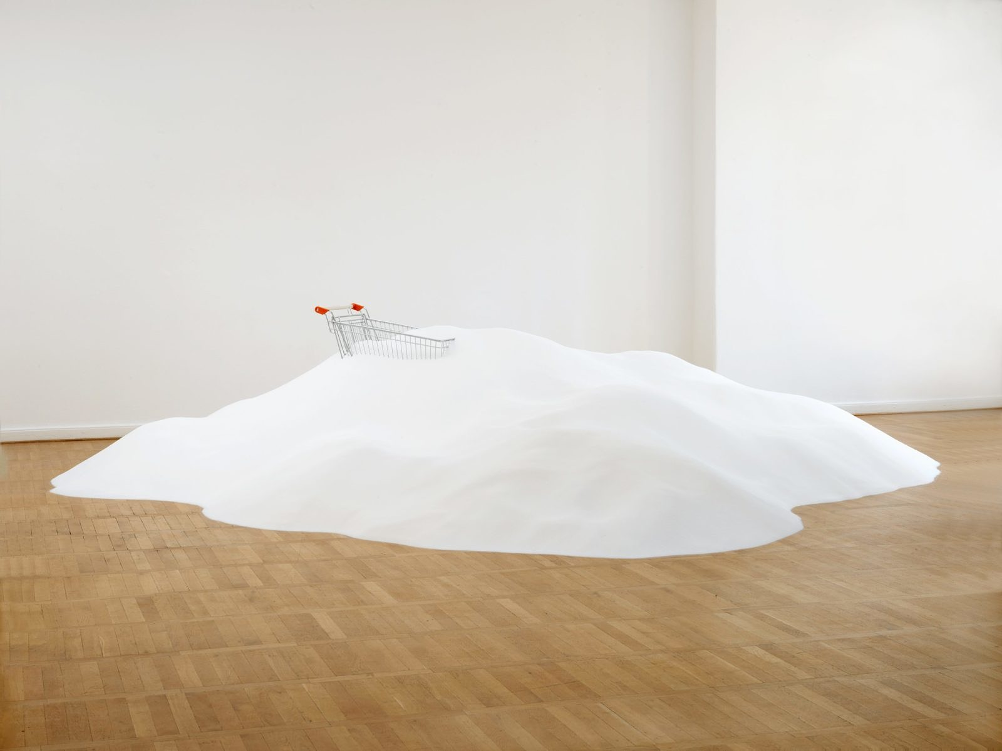
Thomas Rentmeister: Uden titel, 2007/2017.
En indkøbsvogn, der drukner i et tonstungt bjerg af sukker.

Slide 31
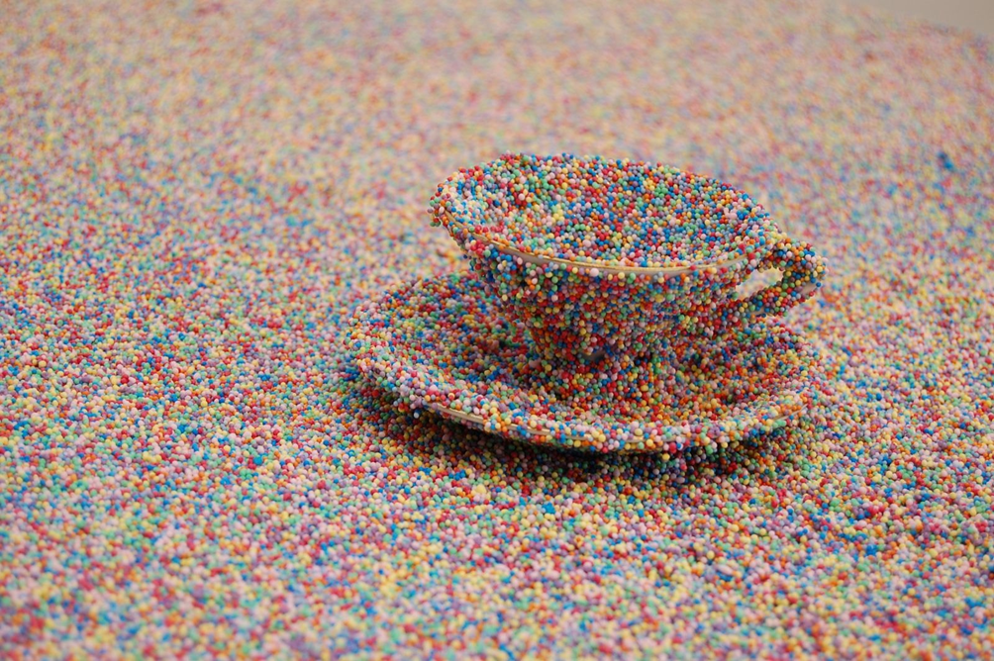
Jette Löwén: Cohesion, 2014.
Værket består af en stol og et bord med en lille kaffekop – alt sammen fuldstændig dækket af krymmel.

Slide 32
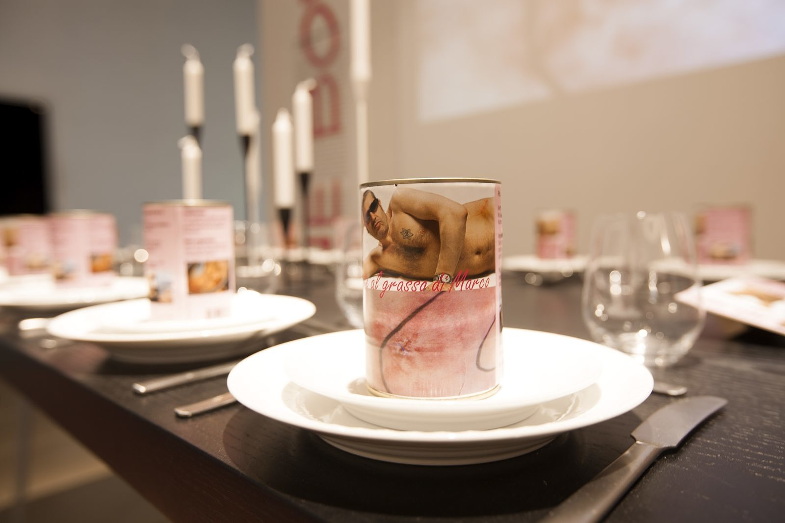
Marco Evaristti: Polpette al Grasso di Marco, 2006.
Den dansk-chilenske kunstner fik foretaget en fedtsugning og tilberedte kødboller med sit eget fedt. Nogle af dem spiste han – resten kom han på dåse.

Slide 33
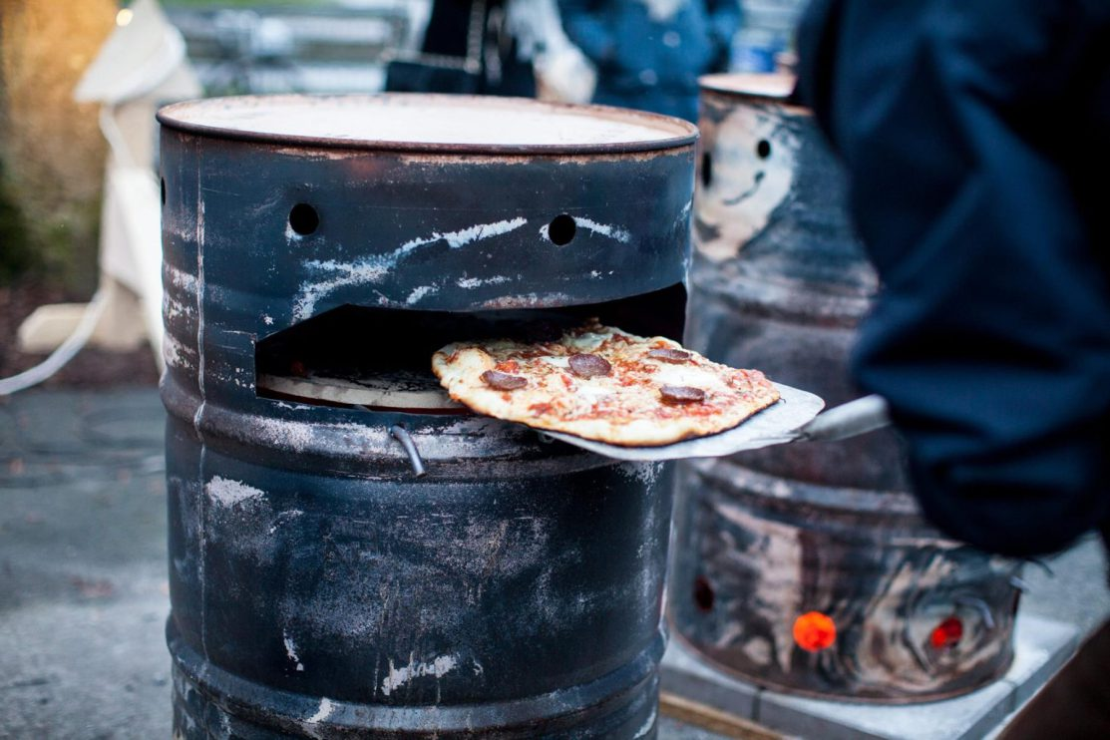
Jesper Aabille:
Let’s Make Pizza, 2014 -?.
Her ved indvielsen af Vinterby-projektet i København, 2016.

Slide 34
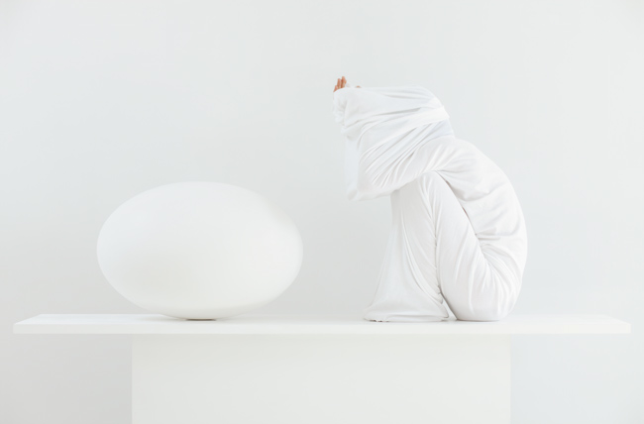
Sophia Kalkau:
White situation, 2012
Fotografi
92 x 129 cm
Sorø kunstmuseum

Slide 35
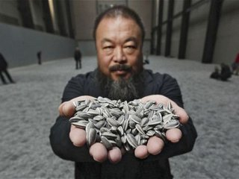
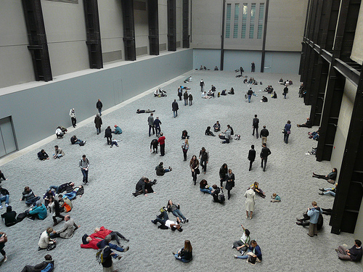
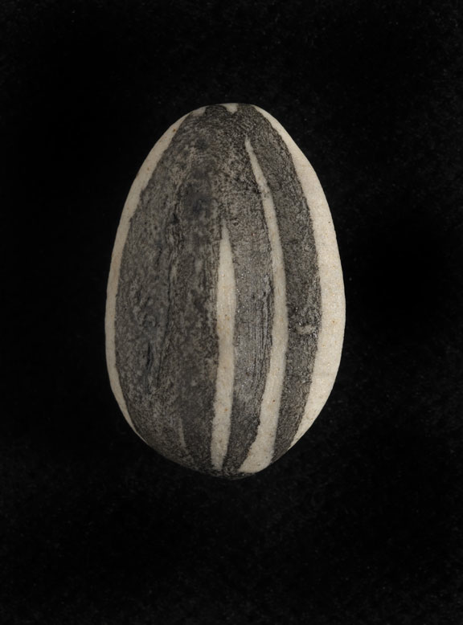
Ai Weiwei:
Sunflower Seeds, 2010.
Installation view from Tate Modern, London
100 millioner solsikkekerner (hånd) lavet af porcelæn.
Some 1,600 artisans worked for two years to make 100 million husks with a combined weight of 150 tonnes.

Slide 36
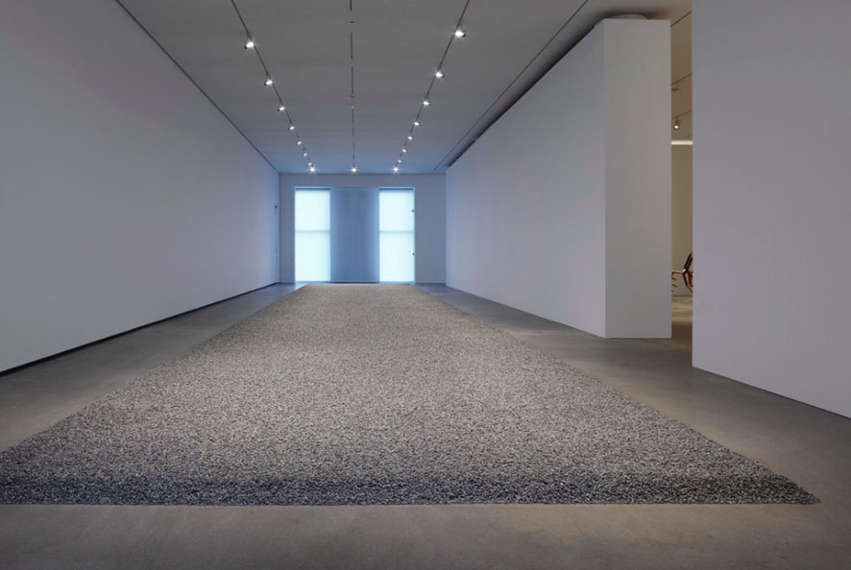
Ai Weiwei:
Sunflower Seeds, 2010
Installation på Faurschou Foundation
Håndlavet af porcelæn
Variabel dimension

Slide 37
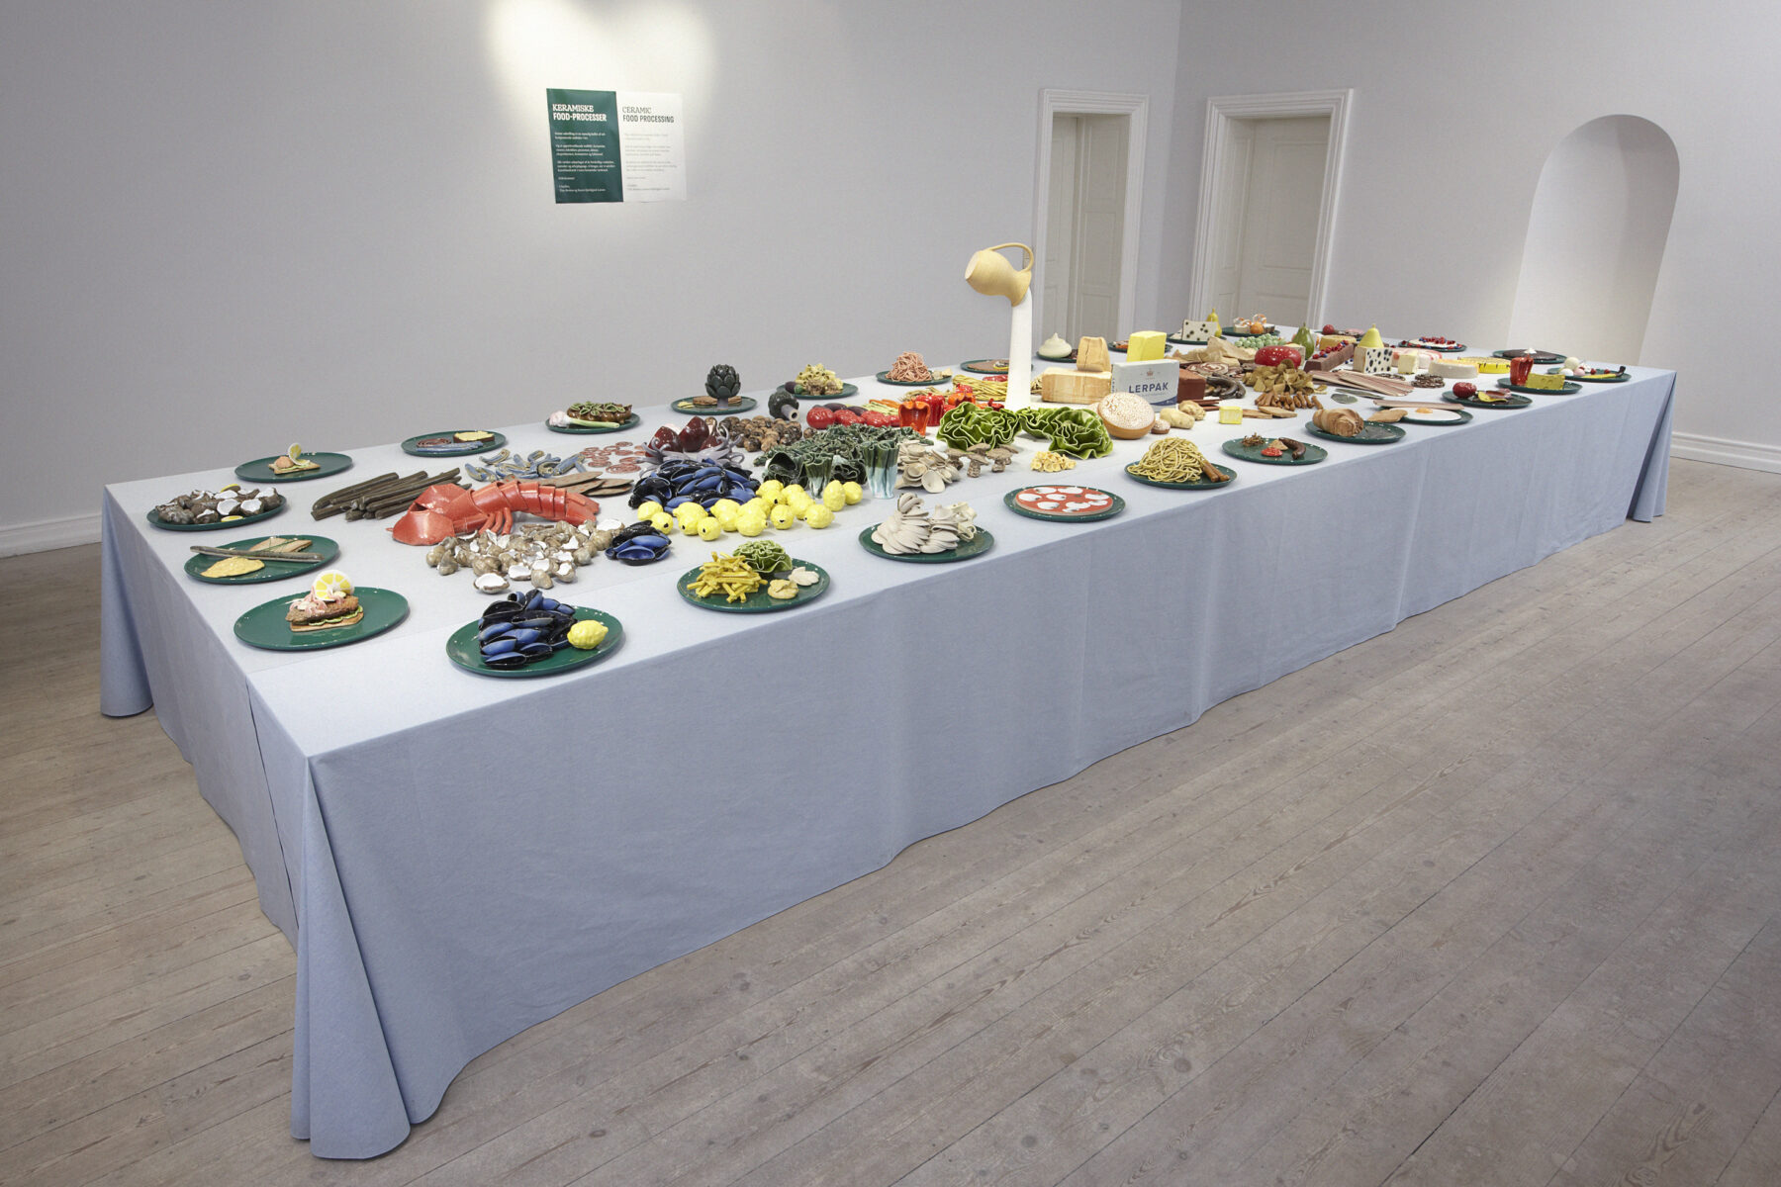
Claydies:
Keramiske foodprocesser, 2025
Keramik
Notes:
https://claydies.dk/keramiske-food-processer/ 2025

Slide 38
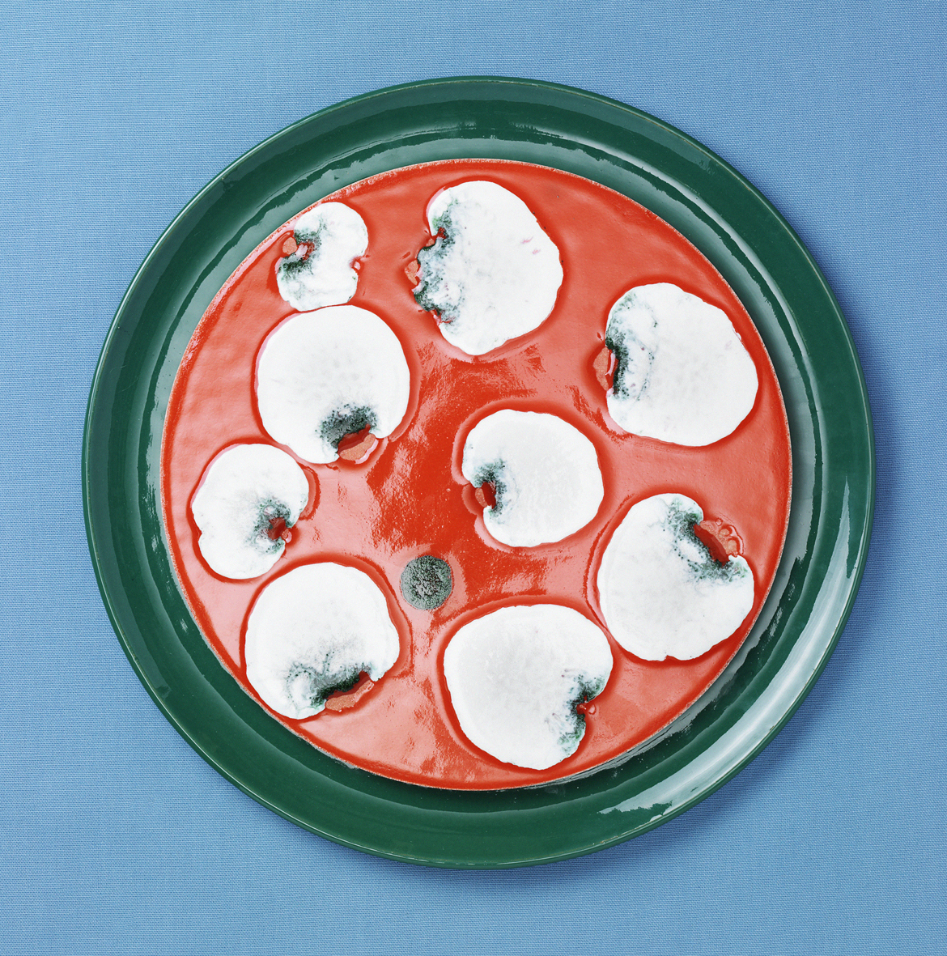
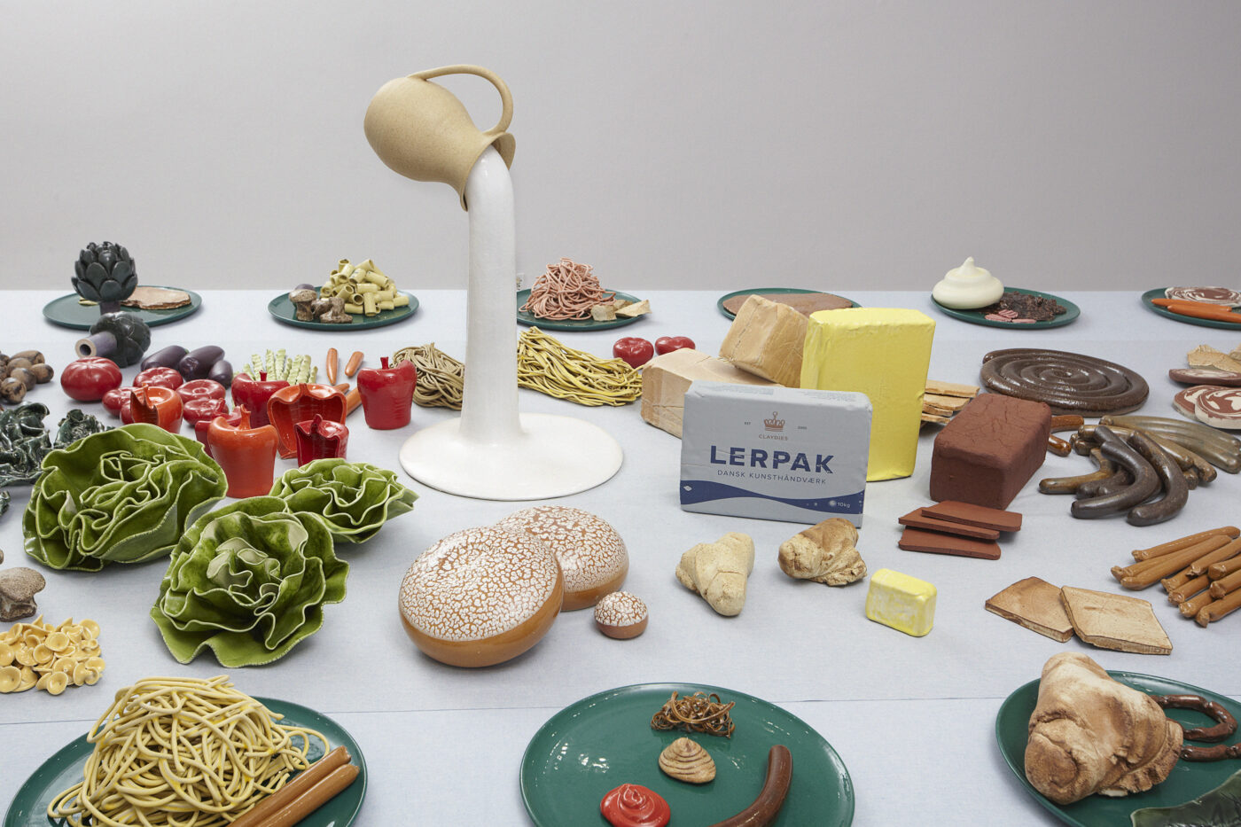
Claydies:
Keramiske foodprocesser, 2025
Keramik

Slide 39
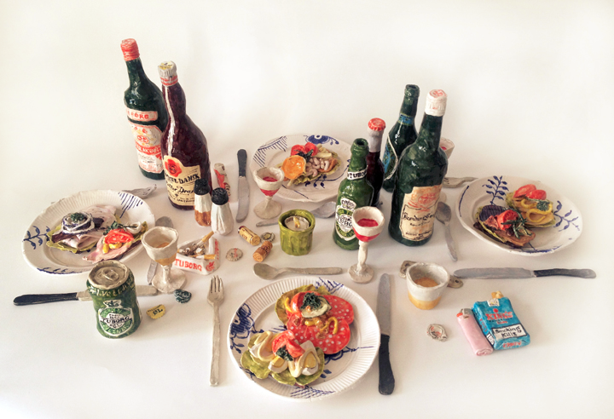
Rosen Eken: Frokosten (The Lunch), 2015
Installation med keramik

Slide 40
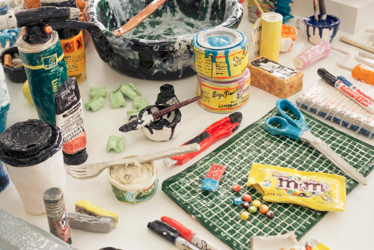
Rose Eken: Tableau (www.v1gallery.com 14th of August-19th of September 2015)
Installation med keramik

Slide 41
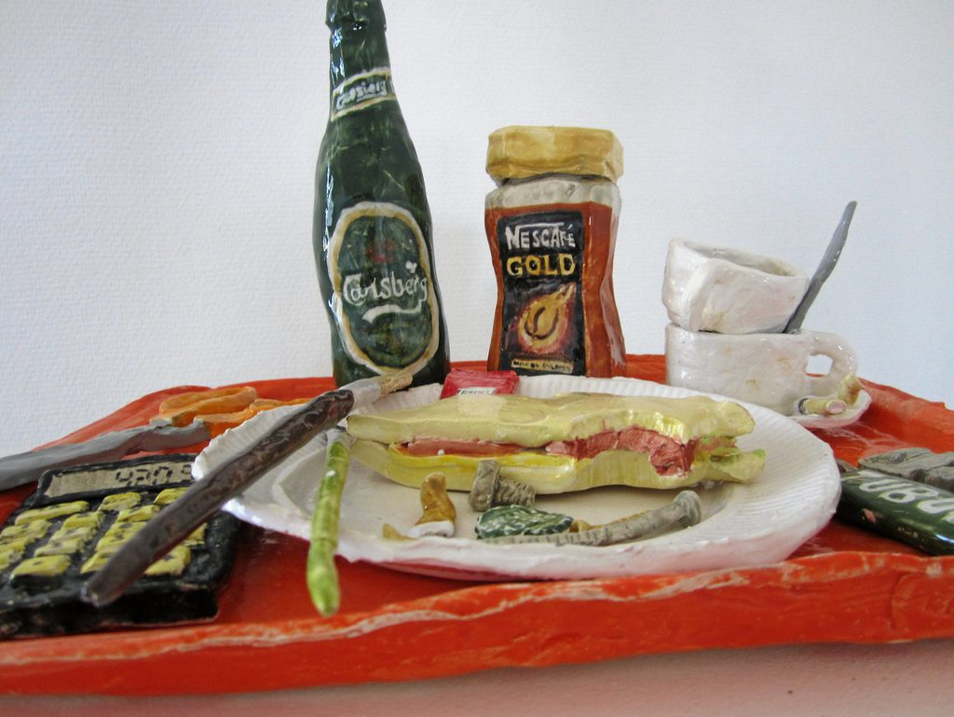
Rose Eken: The Show, 2017.
Installation med keramik
Notes:
Link: https://www.sn.dk/odsherred-kommune/se-billederne-kunstnernes-efterladenskaber-formet-i-keramik/

Slide 42
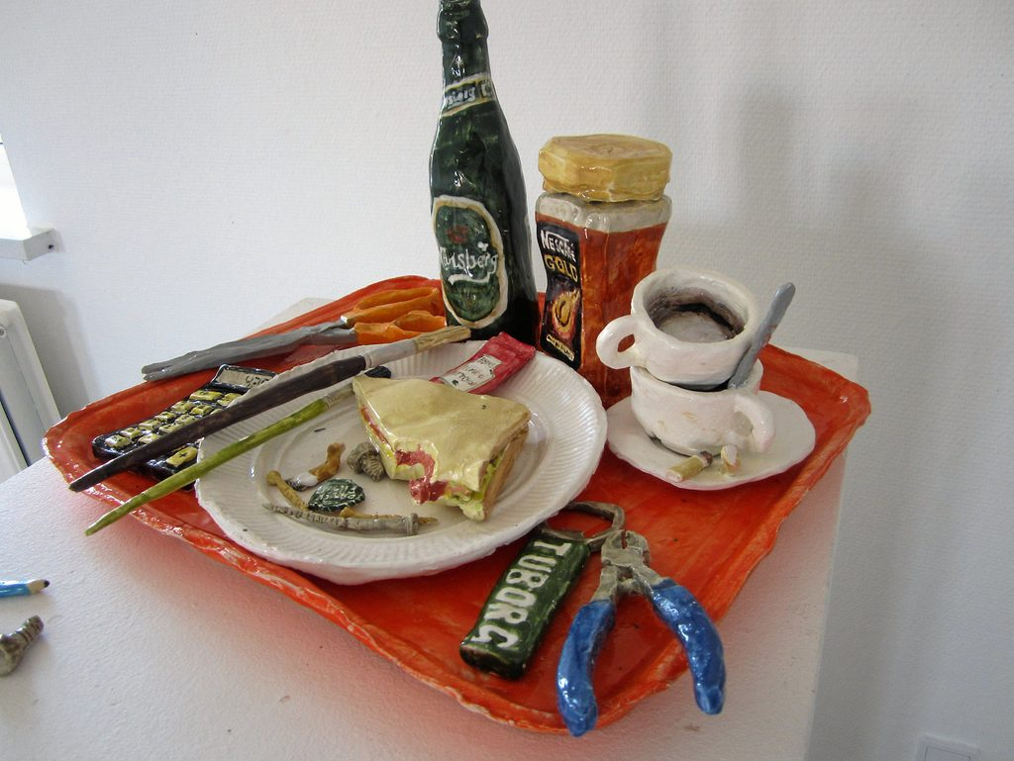
Rose Eken: The Show, 2017.
Installation med keramik

Slide 43
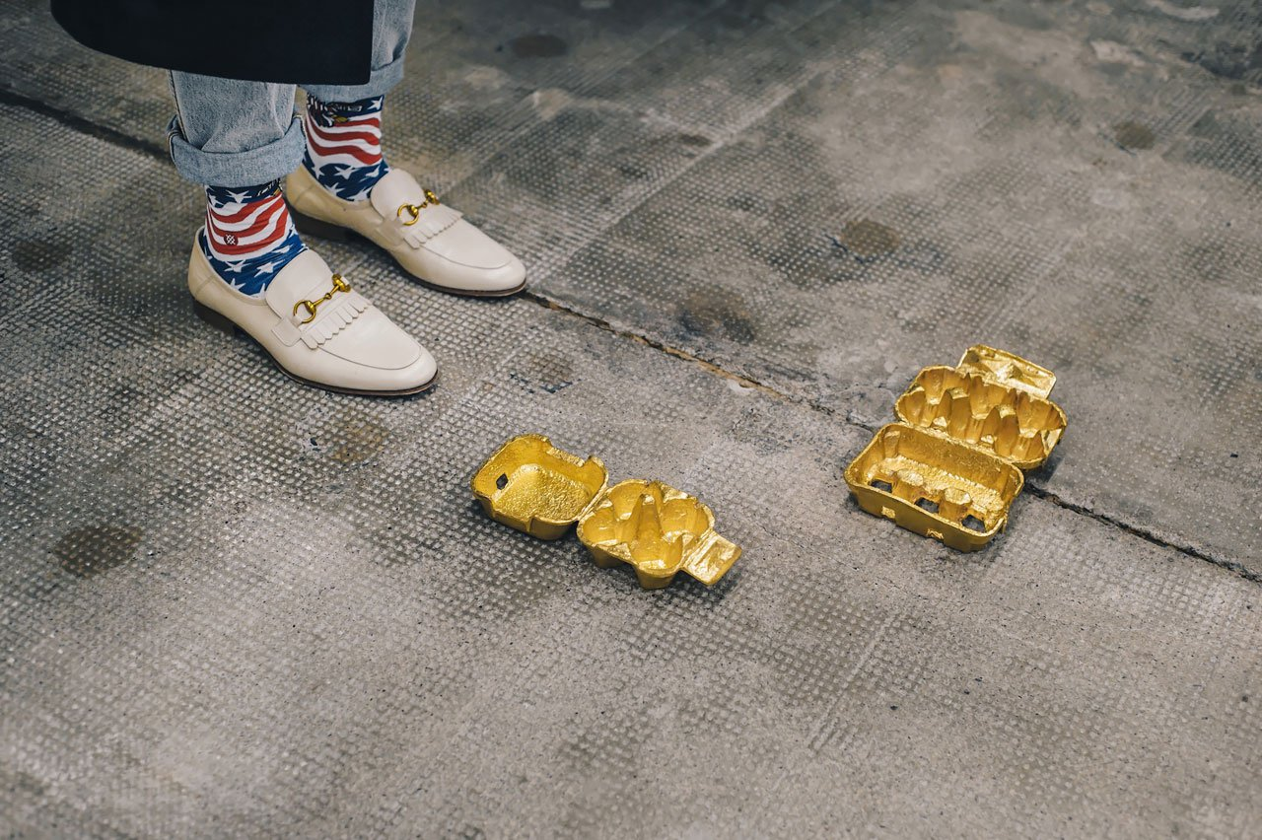
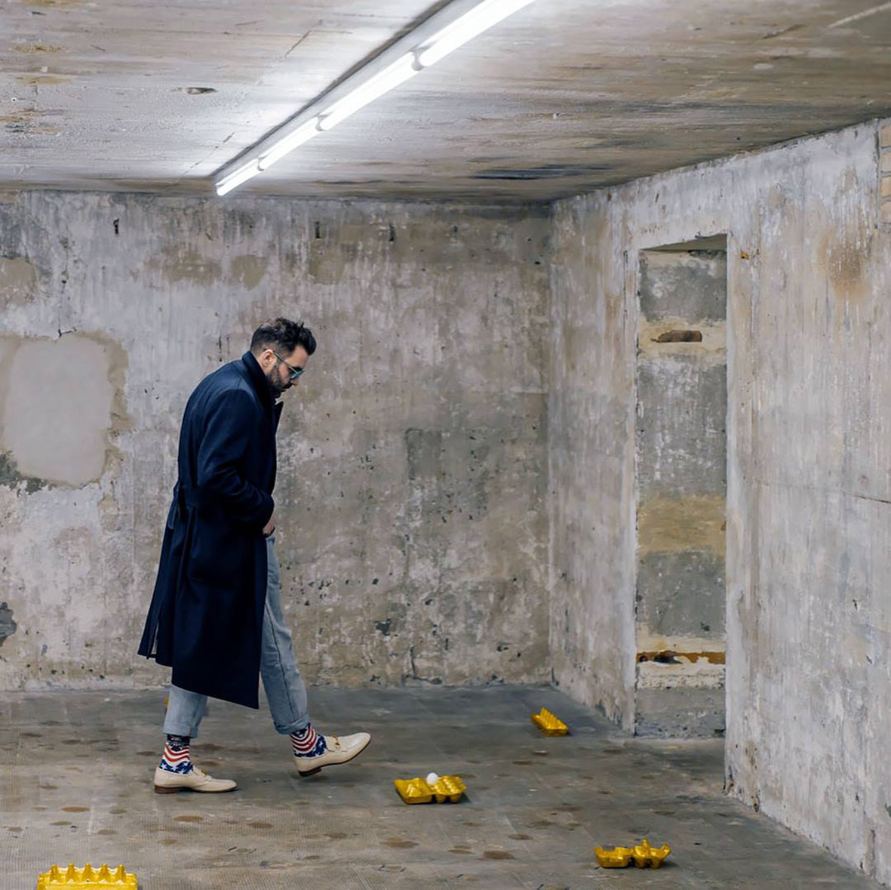
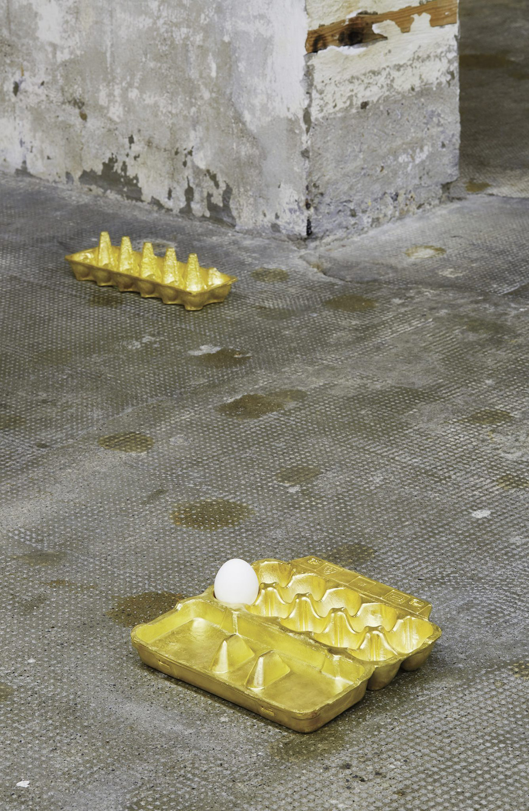
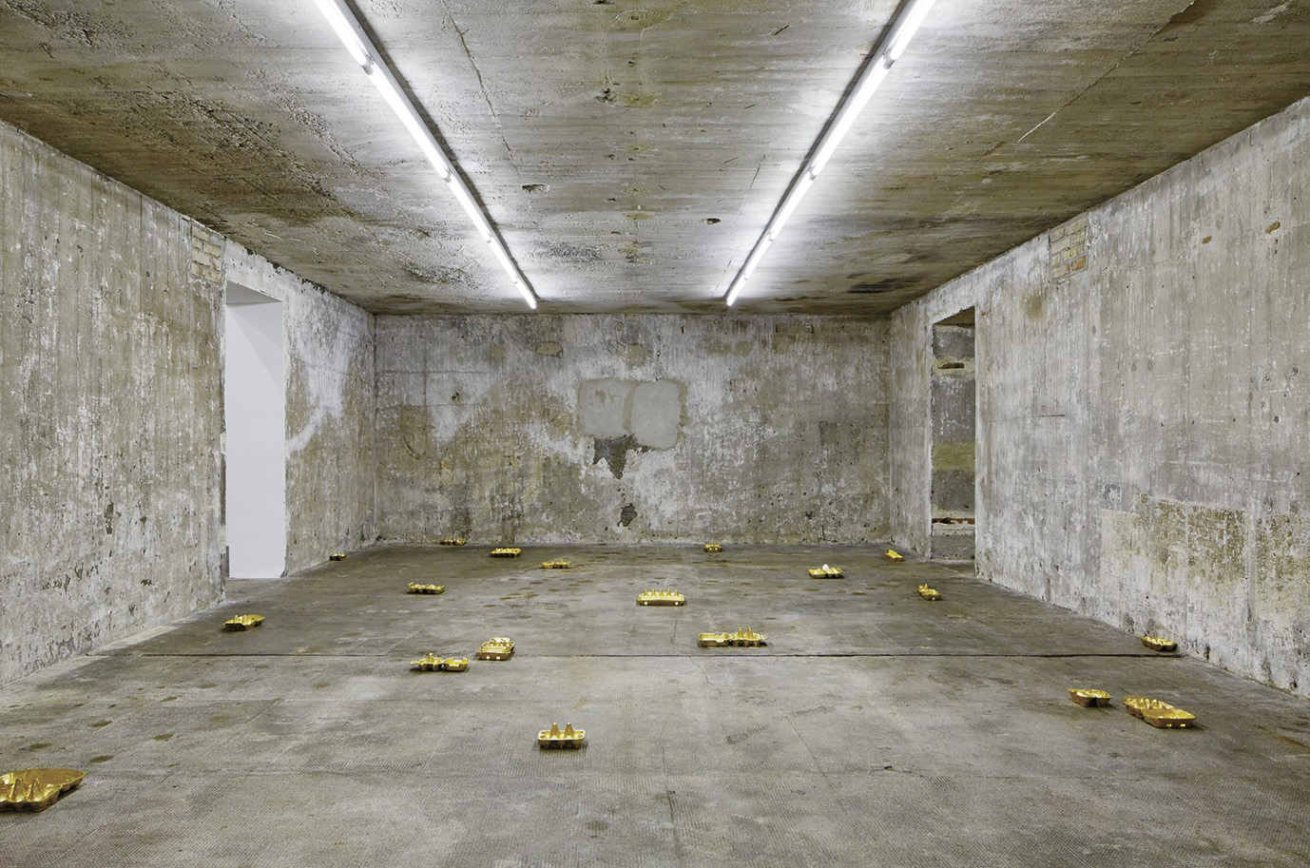
He Xiangyu:
Uden titel, 2017
Bronze, 18K guld
12 objekter, samlede størrelse/areal variabel
Notes:
Egg carton | Bronze casting, fire gilded | 2019
The Noack bronze foundry has realised an unusual and technically demanding project for the artist He Xiangyu, who was born in China in 1986. These are golden casts of 24 ordinary egg cartons, each of which can hold 12 eggs. In his series of Eggholders - impressively displayed in the Boros Collection - He was concerned with openly and admonishingly demonstrating the arbitrariness of value to the viewer. In his installation, he used commercially available chicken eggs from the supermarket, which formed a strong visual and contextual contrast to the gold. In this work of art, the egg as a life-giving and life-sustaining symbol is supposedly of no value, while the transport packaging appears extremely valuable thanks to its golden colour. A good example of the twisted nature of today's society.
Our work consisted of melting and moulding the original cardboard egg cartons directly. After careful metalworking, the castings of the boxes were then fire-gilded - a very rare and almost alchemistic process of gold plating, which makes the artwork even more valuable due to the technical virtuosity of the gilding.
For more information: www.sammlung-boros.de
Pictures: Sammlung Boros/ NOSHE
https://www.noack.berlin/en/references/he-xiangyu/

Slide 44
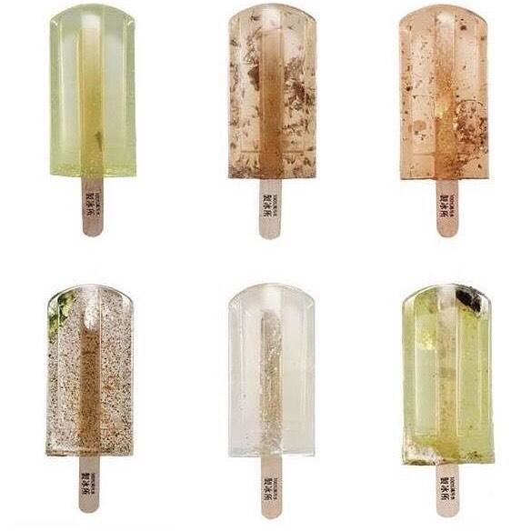
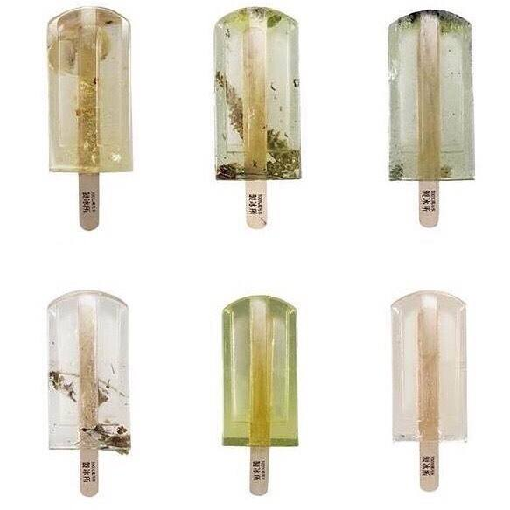
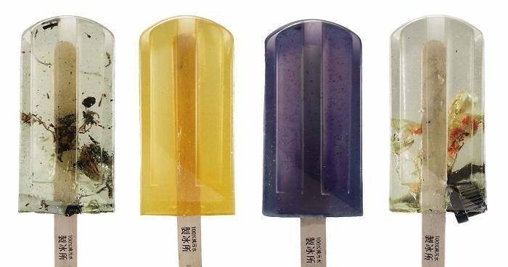
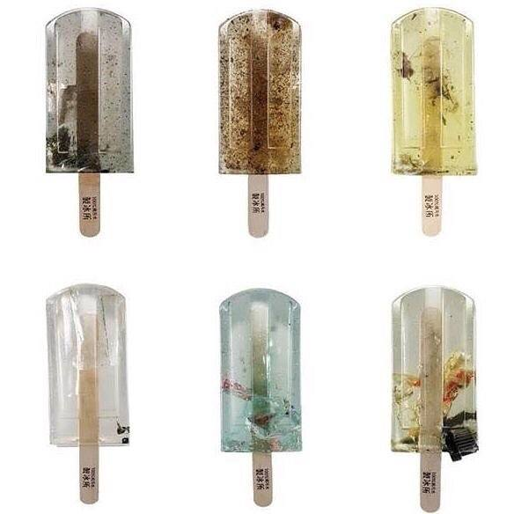
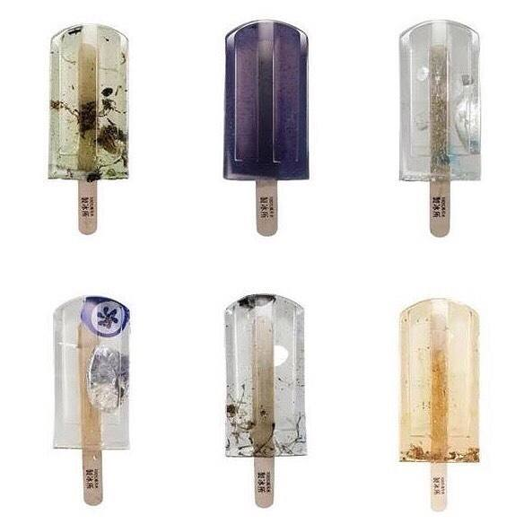
Polluted water popsicles highlight Taiwan’s water pollution problem. Design students from the National Taiwan University of Arts created the 100%純污水製冰所 #PollutedWaterPopsicles project, which aims to raise awareness about rising water pollution due to rapid economic growth and urbanization. 2017
Polyester resin
Polluted water popsicles
Notes:
Polluted water popsicles highlight Taiwan’s water pollution problem. Design students from the National Taiwan University of Arts created the 100%純污水製冰所 #PollutedWaterPopsicles project, which aims to raise awareness about rising water pollution due to rapid economic growth and urbanization.
Focused on environmental change rather than flavor, art students Hung I-chen, Guo Yi-hui, and Cheng Yu-ti from the National Taiwan University of the Arts concocted a line of “frozen treats” titled Polluted Water Popsicles.
The group collected polluted water from 100 locations in Taiwan, first freezing the collected sewage samples and then preserving their creations in polyester resin.
At first glance the visually pleasing treats seem to imitate the aesthetic of recent craft and artisanal food trends. However on closed inspection you can identify the trash contained within each mold—bits of plastic, bottle caps, and wrappers lying within the popsicles’ murky waters.
The project is intended to spread awareness about water pollution and its deep effect on our world’s population. The 100 pieces, which also included designed wrappers, was nominated for the Young Pin Design Award and featured in the New Generation of Design Exhibition this May at the Taipei 101 Taiwan World Trade Center

Slide 45
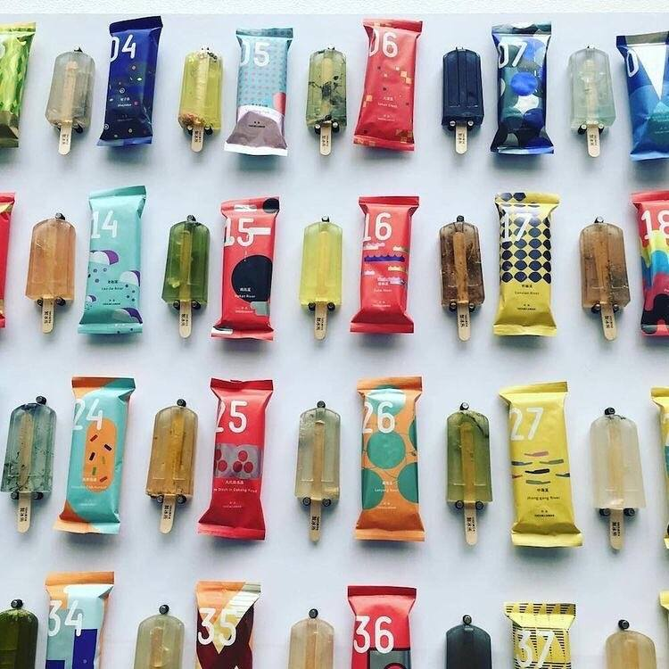
Polluted water popsicles highlight Taiwan’s water pollution problem. 2017
Polyester resin
Polluted water popsicles
Notes:
Design students from the National Taiwan University of Arts created the 100%純污水製冰所 #PollutedWaterPopsicles

Slide 46
EAT ME
Mad i kunst og design │ Trapholt 2017-2018
Notes:
https://trapholt.dk/eat-me-mad-i-kunst-design/

Slide 47


Slide 48
Opgave: Analyse-øvelse: 5 værker
Inddel i 4-8 grupper
Emnerne fordeles:
INDTRYK (motiv / måde at se verden på):
Den oplevelse eller følelse, som kunstneren har haft. Hvad følte kunstneren? Hvordan ser kunstneren verden?
UDTRYK (måde at fortolke verden i kunsten / måde at bruge kunsten som medie):
Kunstnerens måde at formidle følelser, stemninger eller budskaber på gennem værket. Hvordan viser kunstneren sin stemning eller idé? Hvad skal værket til at udtrykke?
INDHOLD (budskab / fortolkning / motiv / emne):
Det værket forestiller eller handler om. Hvad ser jeg i billedet? Hvad handler det om?
VIRKEMIDLER ( materialer / teknikker / elementer):
De teknikker og elementer, kunstneren bruger for at skabe værket og påvirke beskueren.
Fx farver, lys/skygge, komposition, perspektiv, linjer, kontraster, symboler, materialer, teknikker…
Skriv ned individuelt, men diskuter i gruppen + evt. research på kunstnerne
+ forberede en fælles fremlæggelse til NÆSTE GANG

