Slide 1
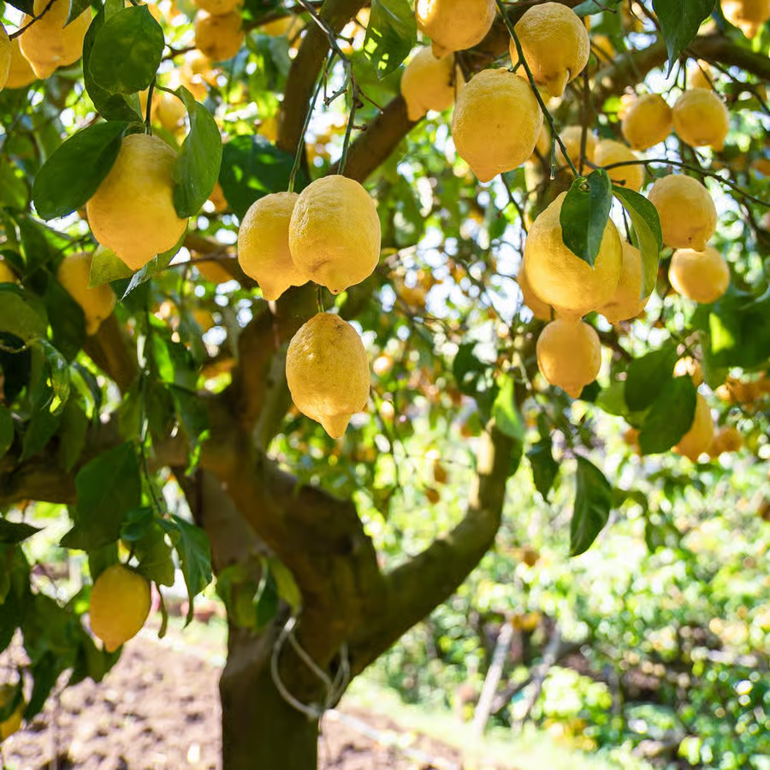
Citroner
Citroner │ Dybde og stoflighed
Notes:
Nedslag i kunsthistorien fra 1600-tallet, modernismen, nyere kunst og samtidskunsten.+ Emily Gjernild om citroner

Slide 2
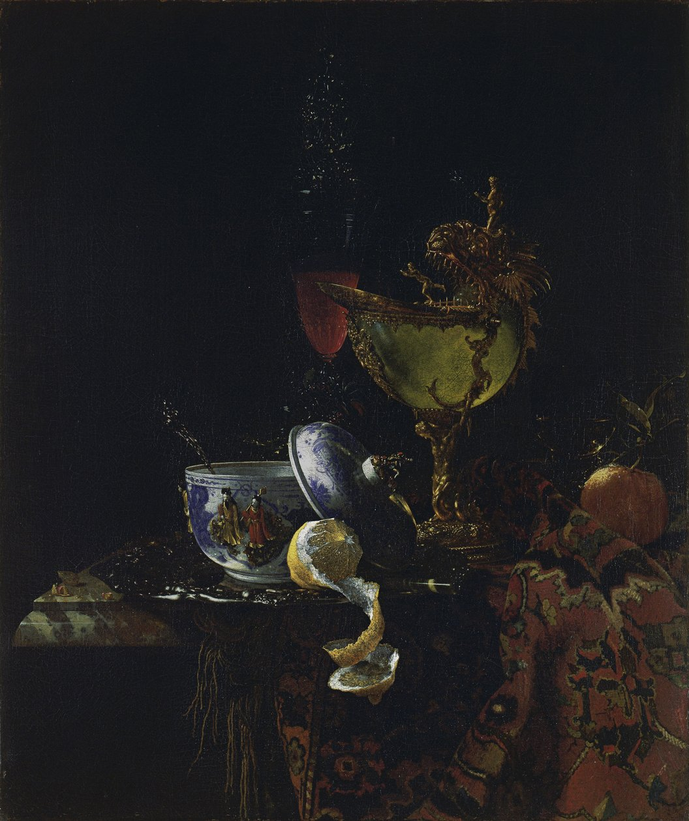
Naturalistisk / mimetisk gengivelse
Willem Kalf:
Stilleben med Nautiluspokal, 1662.
Olie på lærred
Notes:
https://de.wikipedia.org/wiki/Nautiluspokal

Slide 3
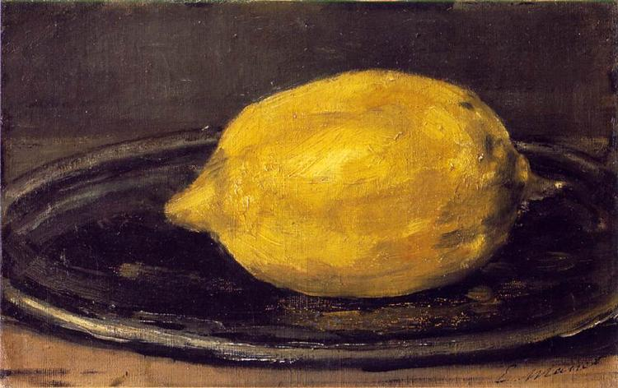
Realistisk gengivelse –henimod det abstrakte – flader af farve
-
Dybde (lys og skygge) – stoflighed i spor af penslen
Edouard Manet: Le Citron, 1880.
Olie på lærred

Slide 4
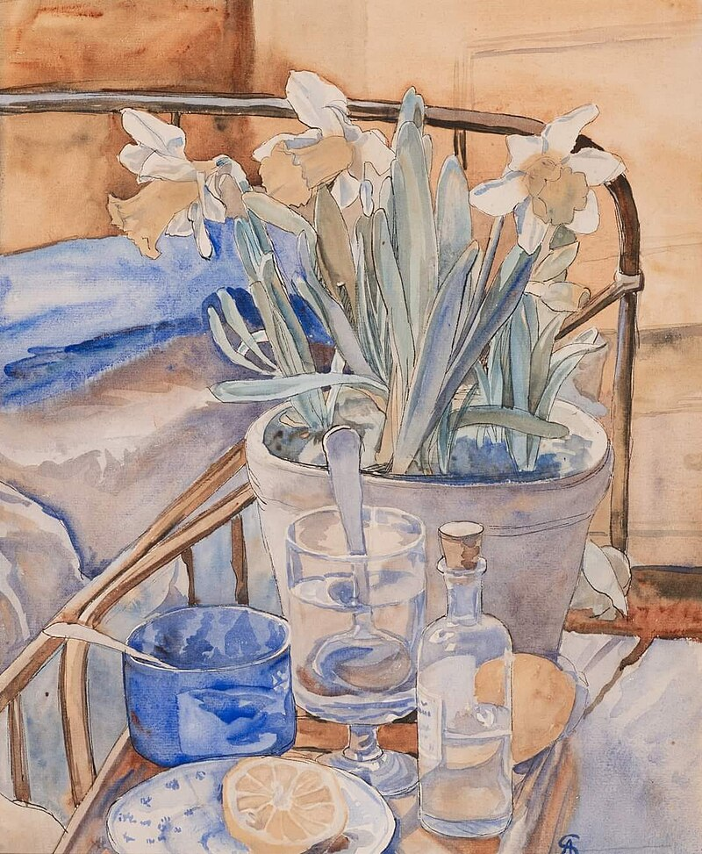
Realistisk gengivelse – hverdagens skønhed -farveflader – dybde, lys og skygge
Anna Syberg:
Ved sygesengen, 1908
Akvarel

Slide 5
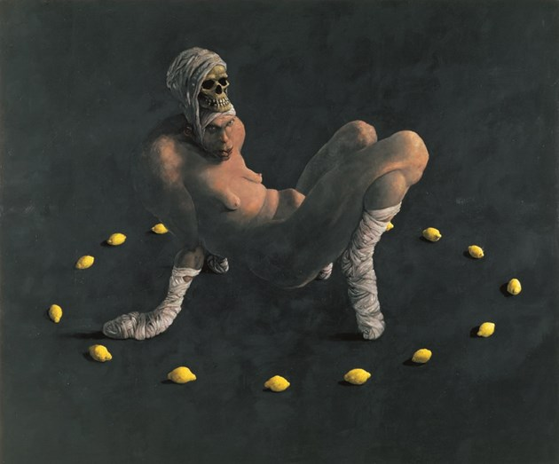
Realistisk gengivelse –symbolsk
Michael Kvium: Naturkreds, 1992.
Olie på lærred, AROS Aarhus Kunstmuseum

Slide 6
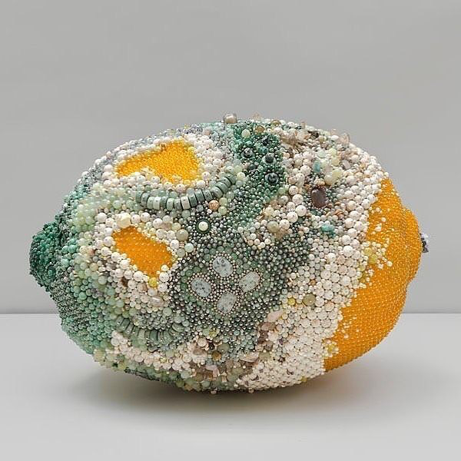
Realistisk gengivelse? –stoflighed gennem materialet
Kathleen Ryan: Bad Lemon (Creep), 2018
Perler

Slide 7
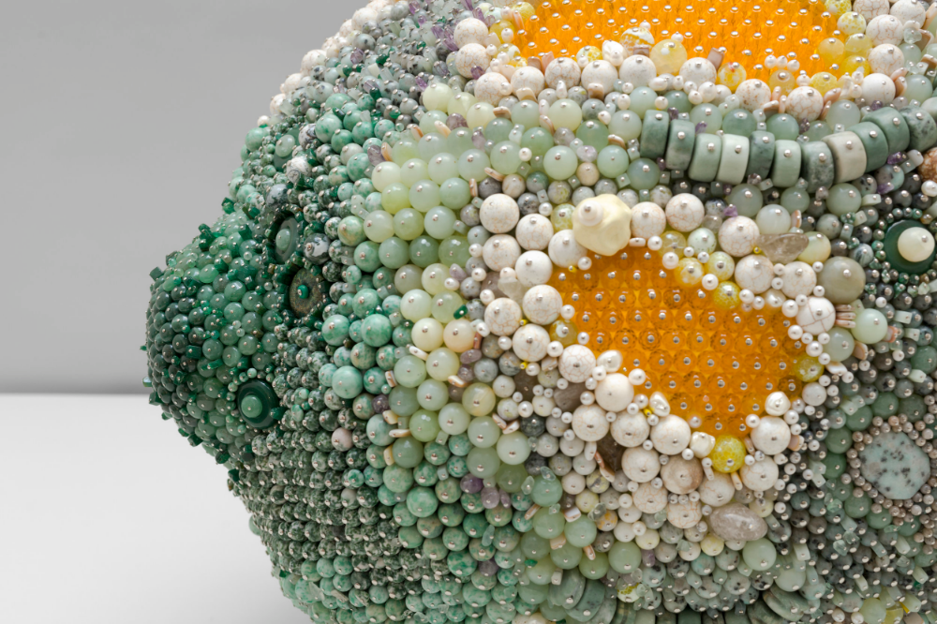

Slide 8
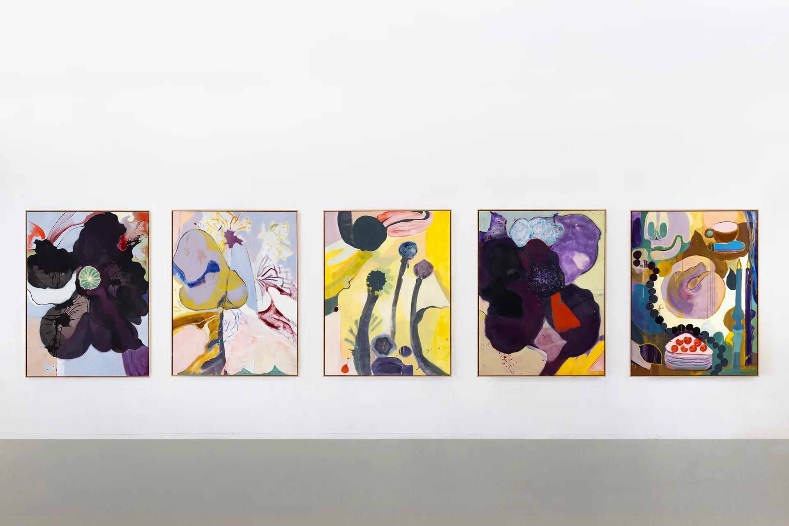
Realistisk gengivelse? – symbolsk betydning? –
Stoflighed gennem materialet og farvernes intensitet
Emily Gernild:
Vanitas. Expectations vs. Reality, 2025
Mixed media
170x130 cm
Notes:
Emily Gernild exhibiting with Galleri Bo Bjerggaard for Special Projects at CHART 2025
Photo by Jan Søndergaard, courtesy of the artist and Galleri Bo Bjerggaard
https://chartartfair.com/journal/news/special-projects-2025

Slide 9
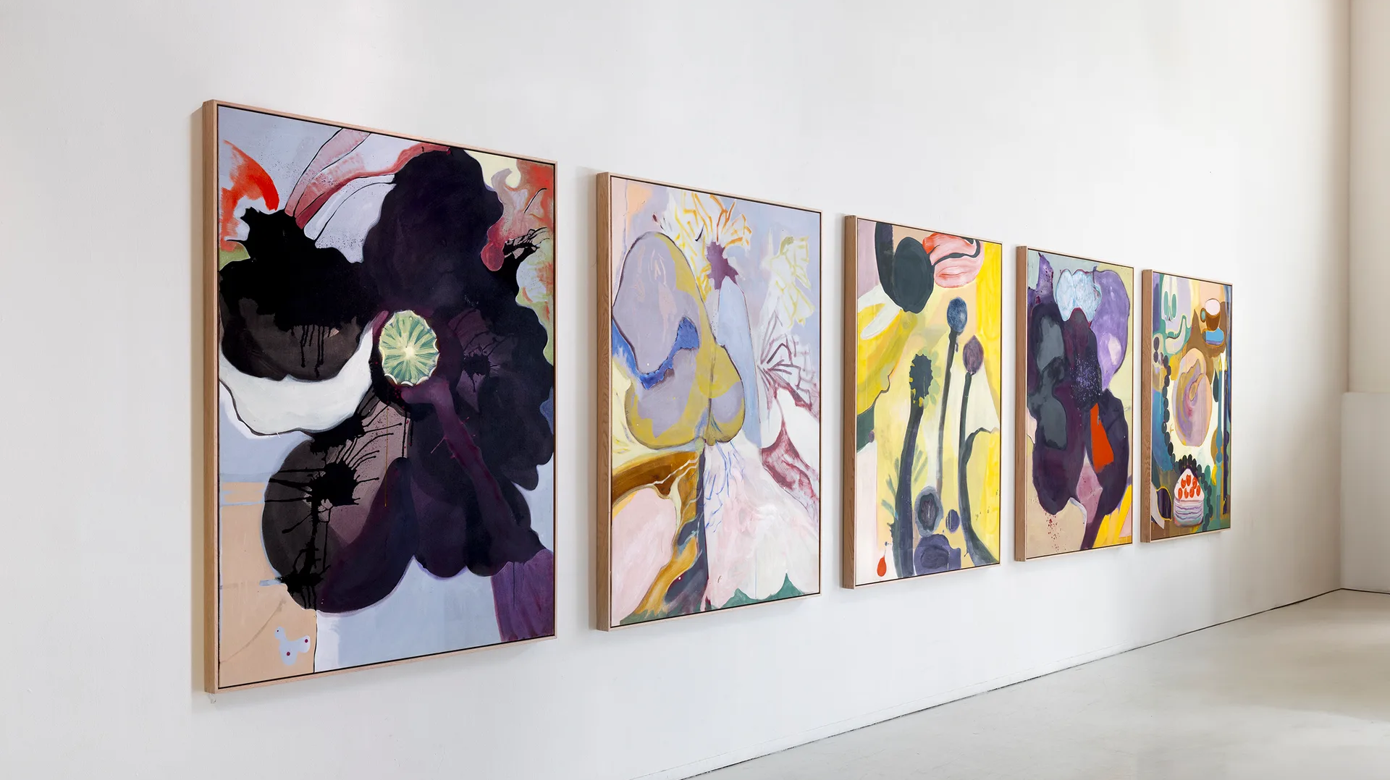
Notes:
Emily Gernild:
Vanitas. Expectations vs. Reality, 2025
Mixed media
170x130 cm

Slide 10
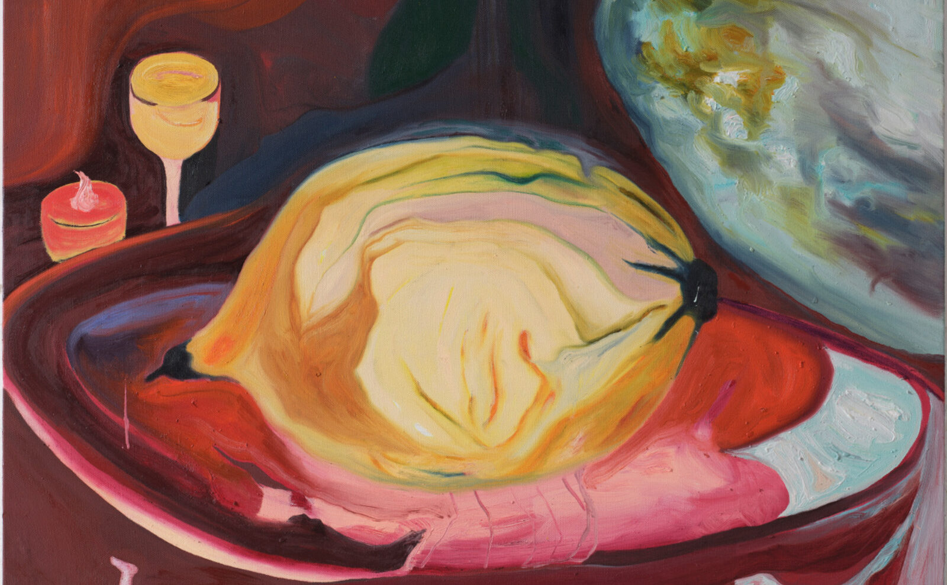
Realistisk gengivelse? – symbolsk betydning? –
Stoflighed gennem materialet og farvernes intensitet –
det lyse og lette – det tunge (harelim og hørlærred)
Emily Gernild:
Nagori, 2025
Mixed media on canvas
Notes:
https://oslcontemporary.com/exhibitions/emily-gernild-nagori
Emily Gernild
Nagori
Exhibition opening Thursday 05.06.2025, 18:00-20:00
NAGORI
Let’s start with a book.
Writer Ryoko Sekiguchi tells us that there is a word for that sensation we feel when we know a fruit, a harvest of the earth, is nearing the end of its seasonality. It’s the final taste. The flavour changes, the scent grows denser. It’s a physical perception, but also an emotional one: we know that soon that fruit will no longer be on our tables. We will miss its taste and the ability to possess it, and it will miss us in return—mutually. The season comes to a close, and something within us prepares to make room for its departure. Nagori. La nostalgie de la saison qui vient de nous quitter (P.O.L., 2018) by Sekiguchi is not only a book, it is a sensory and emotional adventure through the millenary history of the relationship between human beings, the Earth, and its fruits.
“Nagori” is also the title of the exhibition by artist Emily Gernild, which presents a series of paintings on canvas imbued with the sensory and symbolic experience of contact with the most extraordinary and mysterious fruits of the earth: citrus. In the work that gives the exhibition its name, a large bright yellow citrus fruit—perhaps a pomelo, genealogical ancestor of the citrus family—is depicted on a wide plate. The bold lines and swirling brushstrokes do not merely describe the fruit but evoke a deep sense of metamorphosis and time. The paint, dense and sinuous, impresses the materiality of change onto the canvas: the fruit seems to become a symbol of a uterine gestation of time itself.
Citrus fruits become true talismans for other emotional worlds. In Citrus Portal 1 and Citrus Portal 2, both horizontal in format, the shape of the citrus fruit recalls that of an eye: a gaze that travels across different layers of reality. In Lemon Salicifolia, the focus shifts to the verticality of the tree and the uniqueness of this variety, known for its slender leaves that resemble those of a willow. With Delights of the Garden, the still life becomes increasingly rich and elaborate; in The Land of the Lemon Gold, it opens to new earthly delights: flowers, roses, petals, spores, roots. Wild Rose and Thorns offer close-up views of the rose, from the folds of its petals to the pointed architecture of its thorns. Finally, Compost Poetry speaks to the cyclical life of the earth, while Silver Moon lifts our gaze upward into the night sky, when the earth sleeps.
In the town of Palmera, between Valencia and Alicante, in it lies the largest open-air citrus collection in the world, or possibly so. With over 500 varieties of citrus, from ancient grafts to new experimental hybrids, this rare garden of citrus biodiversity (Todolì Citrus Fundaciò) was created with an educational mission, within the citric world that only appears familiar but is, in truth, boundless. Vicente Todolí, its founder, was inspired by the Florentine figure of Cosimo de’ Medici, who in 1550 sublimated his love for citrus into a collection as precious as any work of art. Emily Gernild visited the citrus collection in Palmera on three occasions—twice in 2024 and once in 2025—and it was, for her, a revelatory experience: a perfect portal, in tune with her already evident interest in the subject—just think of her Black Lemons exhibition at Schwarz Contemporary in Berlin in 2021. For Emily Gernild the strongest sensation was always the same, living in that garden of earthly delights: the most important one, the extraordinary epiphany in which all the senses awaken at once.
Emily Gernild leaves a visual imprint of the sensory experience of approaching the citric world, in all its complex whirl of sensations and melancholies. Nagori, in Japanese, literally means “trace,” and in relation to seasonality it expresses that taste which will never return. This is what can be found in Gernild’s Nagori: represented through vivid colours and granitic shadows—traces of the ecstasy of nature perceived through the senses, the mesmerizing gratuity of time, the mysterious elegance of seasonality as it exits the stage, leaving behind a vast void that transforms into a welcoming space for the new.
*
15.05.2025
Alice Ongaro Sartori

Slide 11
NAGORI
Let’s start with a book. Writer Ryoko Sekiguchi tells us that there is a word for that sensation we feel when we know a fruit, a harvest of the earth, is nearing the end of its seasonality. It’s the final taste. The flavour changes, the scent grows denser. It’s a physical perception, but also an emotional one: we know that soon that fruit will no longer be on our tables. We will miss its taste and the ability to possess it, and it will miss us in return—mutually. The season comes to a close, and something within us prepares to make room for its departure. Nagori. La nostalgie de la saison qui vient de nous quitter (P.O.L., 2018) by Sekiguchi is not only a book, it is a sensory and emotional adventure through the millenary history of the relationship between human beings, the Earth, and its fruits.
“Nagori” is also the title of the exhibition by artist Emily Gernild, which presents a series of paintings on canvas imbued with the sensory and symbolic experience of contact with the most extraordinary and mysterious fruits of the earth: citrus. In the work that gives the exhibition its name, a large bright yellow citrus fruit—perhaps a pomelo, genealogical ancestor of the citrus family—is depicted on a wide plate. The bold lines and swirling brushstrokes do not merely describe the fruit but evoke a deep sense of metamorphosis and time. The paint, dense and sinuous, impresses the materiality of change onto the canvas: the fruit seems to become a symbol of a uterine gestation of time itself.

Slide 12
Citrus fruits become true talismans for other emotional worlds. In Citrus Portal 1 and Citrus Portal 2, both horizontal in format, the shape of the citrus fruit recalls that of an eye: a gaze that travels across different layers of reality. In Lemon Salicifolia, the focus shifts to the verticality of the tree and the uniqueness of this variety, known for its slender leaves that resemble those of a willow. With Delights of the Garden, the still life becomes increasingly rich and elaborate; in The Land of the Lemon Gold, it opens to new earthly delights: flowers, roses, petals, spores, roots. Wild Rose and Thorns offer close-up views of the rose, from the folds of its petals to the pointed architecture of its thorns. Finally, Compost Poetry speaks to the cyclical life of the earth, while Silver Moon lifts our gaze upward into the night sky, when the earth sleeps.
In the town of Palmera, between Valencia and Alicante, in it lies the largest open-air citrus collection in the world, or possibly so. With over 500 varieties of citrus, from ancient grafts to new experimental hybrids, this rare garden of citrus biodiversity (Todolì Citrus Fundaciò) was created with an educational mission, within the citric world that only appears familiar but is, in truth, boundless. Vicente Todolí, its founder, was inspired by the Florentine figure of Cosimo de’ Medici, who in 1550 sublimated his love for citrus into a collection as precious as any work of art. Emily Gernild visited the citrus collection in Palmera on three occasions—twice in 2024 and once in 2025—and it was, for her, a revelatory experience: a perfect portal, in tune with her already evident interest in the subject—just think of her Black Lemons exhibition at Schwarz Contemporary in Berlin in 2021. For Emily Gernild the strongest sensation was always the same, living in that garden of earthly delights: the most important one, the extraordinary epiphany in which all the senses awaken at once.
Emily Gernild leaves a visual imprint of the sensory experience of approaching the citric world, in all its complex whirl of sensations and melancholies. Nagori, in Japanese, literally means “trace,” and in relation to seasonality it expresses that taste which will never return. This is what can be found in Gernild’s Nagori: represented through vivid colours and granitic shadows—traces of the ecstasy of nature perceived through the senses, the mesmerizing gratuity of time, the mysterious elegance of seasonality as it exits the stage, leaving behind a vast void that transforms into a welcoming space for the new.
Notes:
https://oslcontemporary.com/exhibitions/emily-gernild-nagori

Slide 13
At arbejde med materialernes virkemidler
Dybde
Stoflighed
Der laves en citron:
Ved hjælp af farvet papir laves en collage.
Der laves slagskygge.
Der kan bruges forskellige nuancer og transparent silkepapir til at skabe dybde.
Ved hjælp af farvet garn
(eller et andet materiale) laves formen af en citron.
Der arbejdes med form, komposition og billedets stoflighed.
Teknikken en fri.
Tænk på begrebet NAGORI

