Slide 1
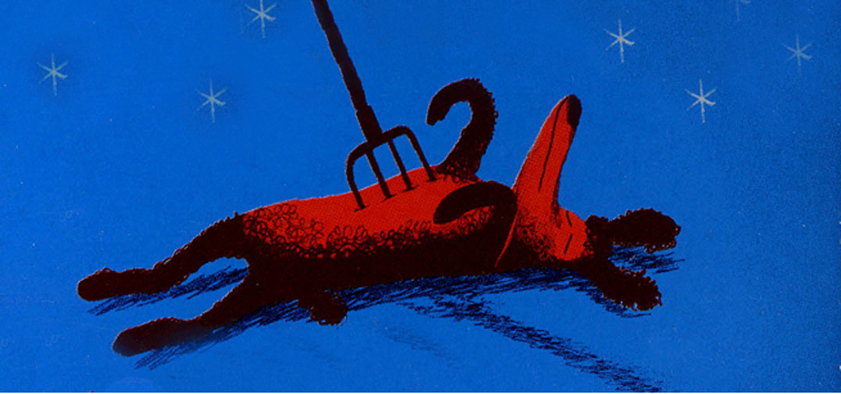
The curious incident of the dog in the night-time
Mark Haddon (2004)

Slide 2
Primary Aims:
- To analyse fiction
- To communicate in english
- To brush up on aspects of grammar

Slide 3
Groups for this course

Slide 4
#1: Ch. 2-53: focus on grammar
Chapter 7, page 5-6:
Identificér udsagnsordene.
Hvilke er uregelmæssige?
Skriv de uregelmæssige udsagnsord ned og
bøj dem i navneform, nutid, datid og kort tillægsform.
I kan finde en oversigt over uregelmæssige udsagnsord i i-bogen Engelsk Fortsættergrammatik:
https://engelskfortsaettergrammatik.systime.dk/index.ph p?id=235

Slide 5
#2: Ch. 2-53: Narrator/point of view
The Narrator. Do page 3 in the study guide: Task 1: re-write… 25 mins.
You will be sharing your writings in class

Slide 6
#3: Ch. 59-139: FOCUS ON THE NARRATOR’s personality traits
  Engage in the task on page 5 in the study guide (Sherlock Holmes). Compare Sherlock Holmes to Christopher, and find SPECIFIC examples in ”The Curious Incident” to substantiate your comparison (page numbers and quotes are required ☺)
II. Do the ”connective detective” exercise on page 6 Be ready to share your findings in class afterwards
    45 mins.

Slide 7
#3: Ch. 59-139: focus on grammar
Chapter 59, page 38-41:
Identificér de sætninger, hvor der bruges udvidet tid og forklar hvorfor.
I kan finde reglerne for brugen af udvidet tid i Fejlstøvsugeren s. 32 og i https://gettingstarted.systime.dk/?id=p175

Slide 8
#4: Ch. 149-173: suspense
Team up in your groups, please
Focus on chapter 149.
Do the storyboard activity on page 8 in the study guide. 30 mins.
Present your storyboards in class.
Make sure you use the right terminology (for film analysis) to explain your storyboard (The English Handbook)

Slide 9
#5: Ch. 149-173: focus on grammar
Chapter 163, page 145-148:
Apostrof bruges på engelsk til 2 formål.
Begge bruges i kapitel 163.
Forklar de 2 former for brug af apostrof på engelsk og giv eksempler fra kapitlet.

Slide 10
#7 Ch. 179-233: Discussion/role-play
We’re going to prepare a hearing.
Should Christopher live with Mother or Father?
Find page 10 in the study guide.
Please form 6 groups and take on the
role of one of the contributors. Prepare a contribution to the hearing.

Slide 11
Groups for THE HEARING
Social worker representing Christopher: | Siobhan, Christopher’s teacher:
Mr Jeavons, the school psychologist: | Mrs Alexander, a concerned neighbour:
A lawyer representing Mother: | A lawyer representing Father:

Slide 12
#8 Ch. 179-233: interpretation
Talk to your study buddy
Discuss the title of the book from what you’ve read on top of page 11 in the study guide.
Should the title be changed? (Discuss – and come up with your own title. Share it in class afterwards)

Slide 13
#9: Themes - discuss
It is a coming of age novel
A theme in the novel is ”individual vs society”
The genre is young adult fiction
The narrator's point of view is essential for this story
Some of the themes in the story are coping with death and mental disorder
It also follows a hero's journey composition, home, out, home
One theme can be “don't judge a book by its cover”
The theme is “Asperger's syndrome”
Christopher is a very dynamic character because he changes perspective on the world from beginning to the end
A theme is “learning to overcome your fear”
As readers, we can immerse ourselves in Christopher’s life

Slide 14
#10: The novel: Christopher’s voice study guide, p. 12-13 (chapter 53)
Work in your own groups
Study all 3 aspects and prepare to share your findings in class. Everybody must be ready to speak on behalf of their group
(connectives)
(types of sentences)
(attitudes, feelings)

Slide 15

#11: Focus on grammar
”Omskriv” s. 264-266 til nutid.
I må selv afgøre, om I vil skrive teksten ned eller læse den højt for hinanden – i nutid, selvfølgelig ☺
Vær opmærksomme på kongruens!

Slide 16
#12: STRUcture/composition
You’ve now read the entire novel.
Find page 2 in the study guide and
Analyse the composition of the book.
Hand in your analysis on Lectio in the assignments folder ”The Curious Composition”

