Slide 1

Structure
Introduction paragraph, topic sentences and analysis vs. summary
Points on writing

Slide 2
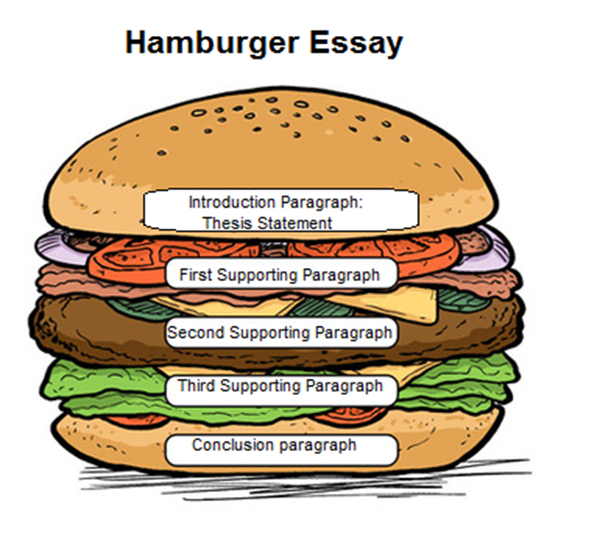
the bun has the same ingredients (top/bottom) and holds the burger together. the body paragraphs hold the main substance of the burger.

Slide 3

Introduction
Fiction – Non-fiction
1. Hook – Start with an interesting opening sentence/statement/question
Animal Farm
What happens when a revolution meant to create equality ends in even greater oppression?
Power has a way of corrupting even those who promise to use it for good.
Throughout history, revolutions have often begun with hope but ended in control and corruption.
Stanford Prison Experiment
How quickly can ordinary people turn cruel when given power over others?
Power doesn’t just reveal who we are, it can change us completely.
In 1971, a psychological experiment meant to last two weeks was shut down after only six days.

Slide 4

Introduction
Fiction – Non-fiction
2. A little meat on the bones
Briefly introduce the topic or introduce the idea of your text in a wider context.
- The question of how much equality is too much has long been debated in political and social thought.
- Throughout history, societies have struggled to balance the desire for equality with the need to protect individual freedom.
- Efforts to create a perfectly equal society can sometimes lead to unexpected and troubling consequences.

Slide 5

Introduction
Fiction – Non-fiction
3. Introduce the title and author of your text.
- Animal Farm by George Orwell is a political allegory that tells the story of farm animals who rebel against their human owner.
- Animal Farm, written by George Orwell, is an allegorical novel that uses a group of farm animals to represent the events and consequences of the Russian Revolution.

Slide 6

Introduction
Fiction – Non-fiction
4. Thesis (The main idea of your essay)
This essay will show that the story warns about the dangers of tradition and conformity.
This essay will show that climate change is a serious problem that affects the environment and human life.

Slide 7
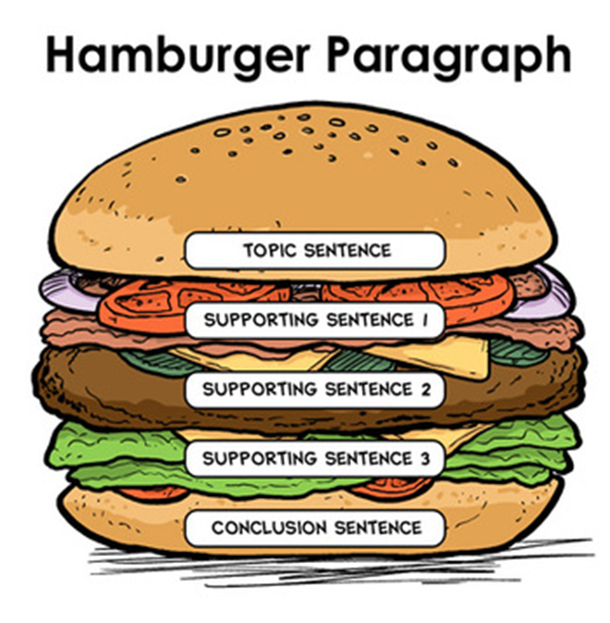
Body paragraphs
One topic per paragraph
Fiction – Non-fiction
Important! Stick to one topic within each paragraph
Fiction: e.g.
Paragraph 1: Characters
Paragraph 2: Setting
Paragraph 3: Theme
Non-fiction e.g.
Paragraph 1: Main idea
Paragraph 2: Receiver
Paragraph 3: Tone/language
Paragraph 4: Author’s purpose

Slide 8
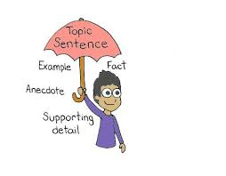
Body paragraphs
A topic sentence introduces the topic of the paragraph in a clear manner and connects to the thesis of your essay.
Topic sentences
Fiction
The character of Napoleon shows how power can lead to corruption.
The story highlights the danger of blindly following authority.
Non-fiction
The author’s purpose is to raise awareness about the dangers of climate change.
The article is clearly aimed at a particular audience, which influences how the information is presented.

Slide 9

Analysis vs. summary
How to move away from summarizing and towards a more analytical text?
Understanding and Meaning
- What is really happening here (beyond the surface)?
- What does this example/event/fact mean?
- Why is this important?
Why questions
Why did the author include this?
Why does this character act this way?
Why is this detail/fact important?

Slide 10

Fiction
How to move away from summarizing and towards a more analytical text?
ASK YOURSELF E.G.:
What does this show about the character?
How does this event impact the story?
What message is the author sending here?
How does this relate to the theme?
What is the deeper meaning behind this scene?
After each sentence ask „So What? or Why does it matter?“
e.g.
Instead of just saying: The character lied.
Say: The character‘s lying shows that he is afraid of the truth.
Don´t just describe but analyse!

Slide 11

NON- Fiction
How to move away from summarizing and towards a more analytical text?
ASK YOURSELF E.G.:
What is the author trying to prove?
How does this fact support the main idea?
Why did the author include this example?
What does this tell the reader?
How does this information connect to the bigger picture?
After each sentence ask „So What? or Why does it matter?“
e.g.
Instead of just saying: The sea ice is melting.
Say: The sea ice in the Arctic is melting, which is causing rising sea levels and threatening wildlife habitats.
Don´t just describe but analyse!

