Slide 1
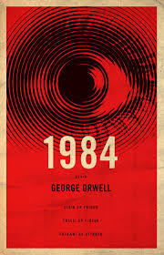
1984 Crash Course
Key Ideas from George Orwell's Novel (1949)

Slide 2
What is 1984?
A dystopian novel about a society controlled by a powerful government.
Key themes:
Totalitarian power
Surveillance
Propaganda
Psychological control

Slide 3
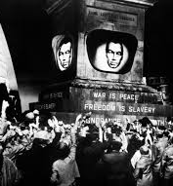
Group work
Big Brother
Thoughtcrime
Doublethink
Newspeak
Memory holes

Slide 4

Group work
1. Explain the concept in your own words
2. Discuss why a government might use it
3. Give a modern or historical example

Slide 5
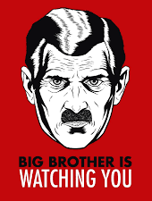
Big Brother & Surveillance
Big Brother is the symbolic leader of the ruling Party.
Citizens are constantly watched through telescreens.
Result: People control their own behavior because they believe they are always being observed.

Slide 6
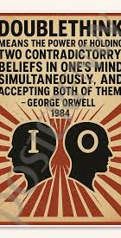
Doublethink
Doublethink means accepting two contradictory ideas at the same time.
Examples:
War is Peace
Freedom is Slavery
Ignorance is Strength

Slide 7
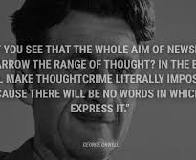
Newspeak
Newspeak is a simplified language designed to limit thought.
If people do not have words for ideas like freedom or rebellion it becomes harder to think about them.

Slide 8
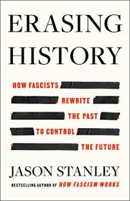
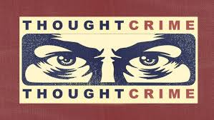
Thoughtcrime & Rewriting History
Thoughtcrime: Thinking against the Party.
Rewriting history: The government changes past records so it always appears correct.
Control of information = control of reality.

Slide 9
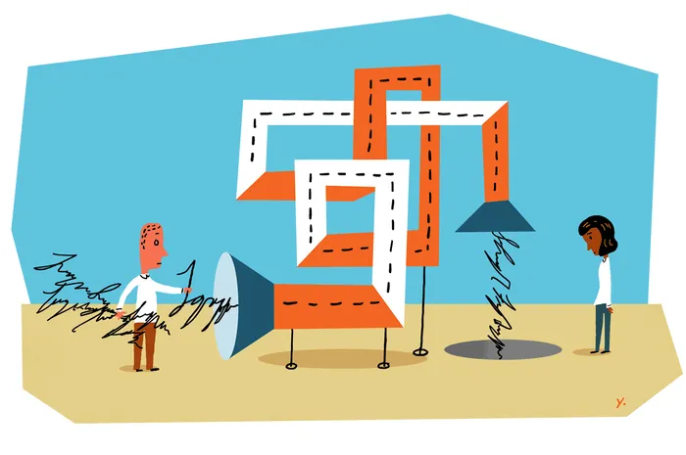
Memory holes
Small openings/shutes in office walles used to dispose of documents (incineration)
= Rewriting history
= Editing the past – Creating the truth – Controlling thought
Symbolizes how information can be edited or manipulated.
Animal Farm?

Slide 10
The Ministries
Ministry of Truth (Minitrue): Fabricates propaganda, revises historical records, and controls media.
Ministry of Love (Minilove): Maintains law and order through fear, torture, and brainwashing.
Ministry of Peace (Minipax): Manages perpetual war.
Ministry of Plenty (Miniplenty): Manages the economy, enforcing poverty and rationing.

Slide 11
Discussion
• Why might governments want to control information?
• Why does surveillance change behavior?
• Can language influence how people think?
• Could something like this happen in modern societies?

