Slide 1

Debates
NGK 2026

Slide 2
Aim
The aim of this project is to practice oral skills and critical thinking.

Slide 3
Grading
Grading will be based on the quality of the arguments/speeches, participant’s performance, and the level of English used.
Again, use your own wording. Do not copy whole sentences or chunks of sentences (rephrase- use your own words). You will submit a script of your speeches into Lectio.

Slide 4
When?
18th of May

Slide 5
Rules and Tips

Slide 6
Rules
· Speak up, and do not read from a script
· Use good English, do not use swearwords and stay relatively formal.
· You can use pictures and props within reason (2-5 items), but not slides with text.
· You are not allowed to use computers and phones during the competition.

Slide 7
Tips
· Start by using a formal address: “Teacher, fellow students!”
· Use real arguments, keep your focus on the topic.
Do not go overboard with theatrics.

Slide 8
Structure

Slide 9
Structure – First Affirmative/Opposing Speaker
Introduction:
Hook – Context/background – team roles – Thesis Statement
Main body:
PEEL: for each main argument
Point (Topic sentence) – Explanation – Evidence – Link (concluding sentence)
Conclusion: Summarize main arguments

Slide 10
PEEL - Example
Point: Single-use plastics cause significant environmental harm.
Explanation: Single-use plastics are often discarded after one use and take hundreds of years to decompose, leading to pollution.
Evidence: Studies show that 91% of plastic is not recycled and ends up in landfills or oceans, harming wildlife and ecosystems.
Link: Therefore, banning single-use plastics would reduce this pollution, making our motion necessary for environmental protection.

Slide 11
Introducing Arguments
Let me come to my first/second/…/next argument: [concise label of argument]
My first/… argument is:
The first/… reason why we’re prop/opposing this motion is: explaining arguments:
[rather abstract explanation on how the argument should work] giving examples:
In fact, you can find many examples for this in real life. Just think of…
And there are similar cases, such as…, …
So in this simple example we can clearly see the effect of …
So as we have seen [argument label], and therefore [motion].
Now because of this …, we have to support this motion.

Slide 12
Summarizing and Ending Your Speeches
So Ladies and Gentlemen, what have I told you today? Firstly …, Secondly..
[some nice closing words]
And for all of these reasons, the motion must stand/fall.

Slide 13
Possible topics
“Under extreme pressure, morality becomes flexible”
“Systems of control are most effective when people enforce them on themselves”
“The desire to belong is stronger than the desire to be free”
“Most people believe they would resist—but wouldn’t”
“Surveillance does more harm than good”
“A completely equal society is impossible”
“Controlling language is the most effective way to control thought”
“The greatest threat to oppressive systems is awareness”

Slide 14
Include at least 2 references to…
Animal Farm
Harrison Bergeron
1984
The heist
Nosedive

Slide 15
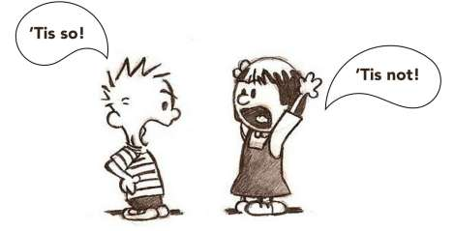
Good Luck ☺

